Slide 1


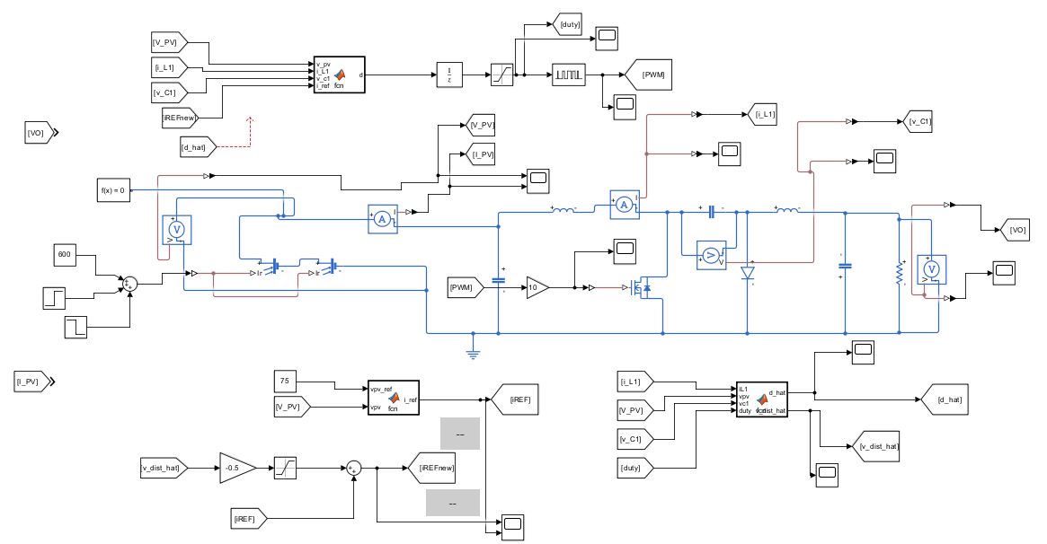
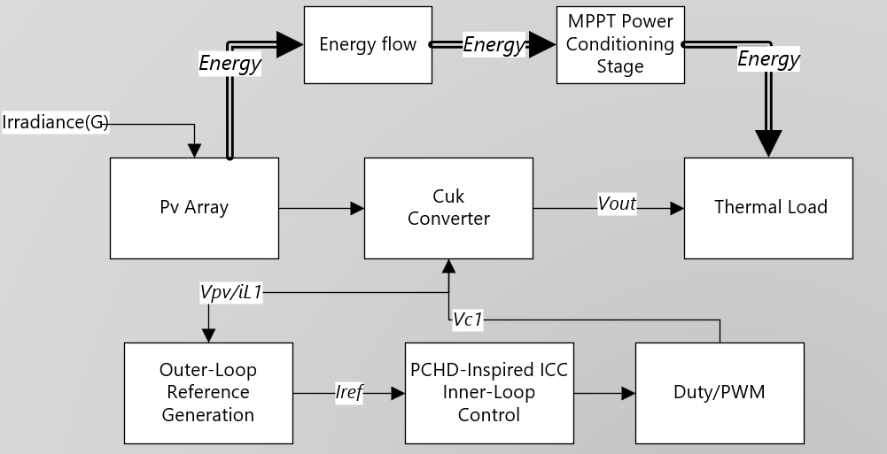
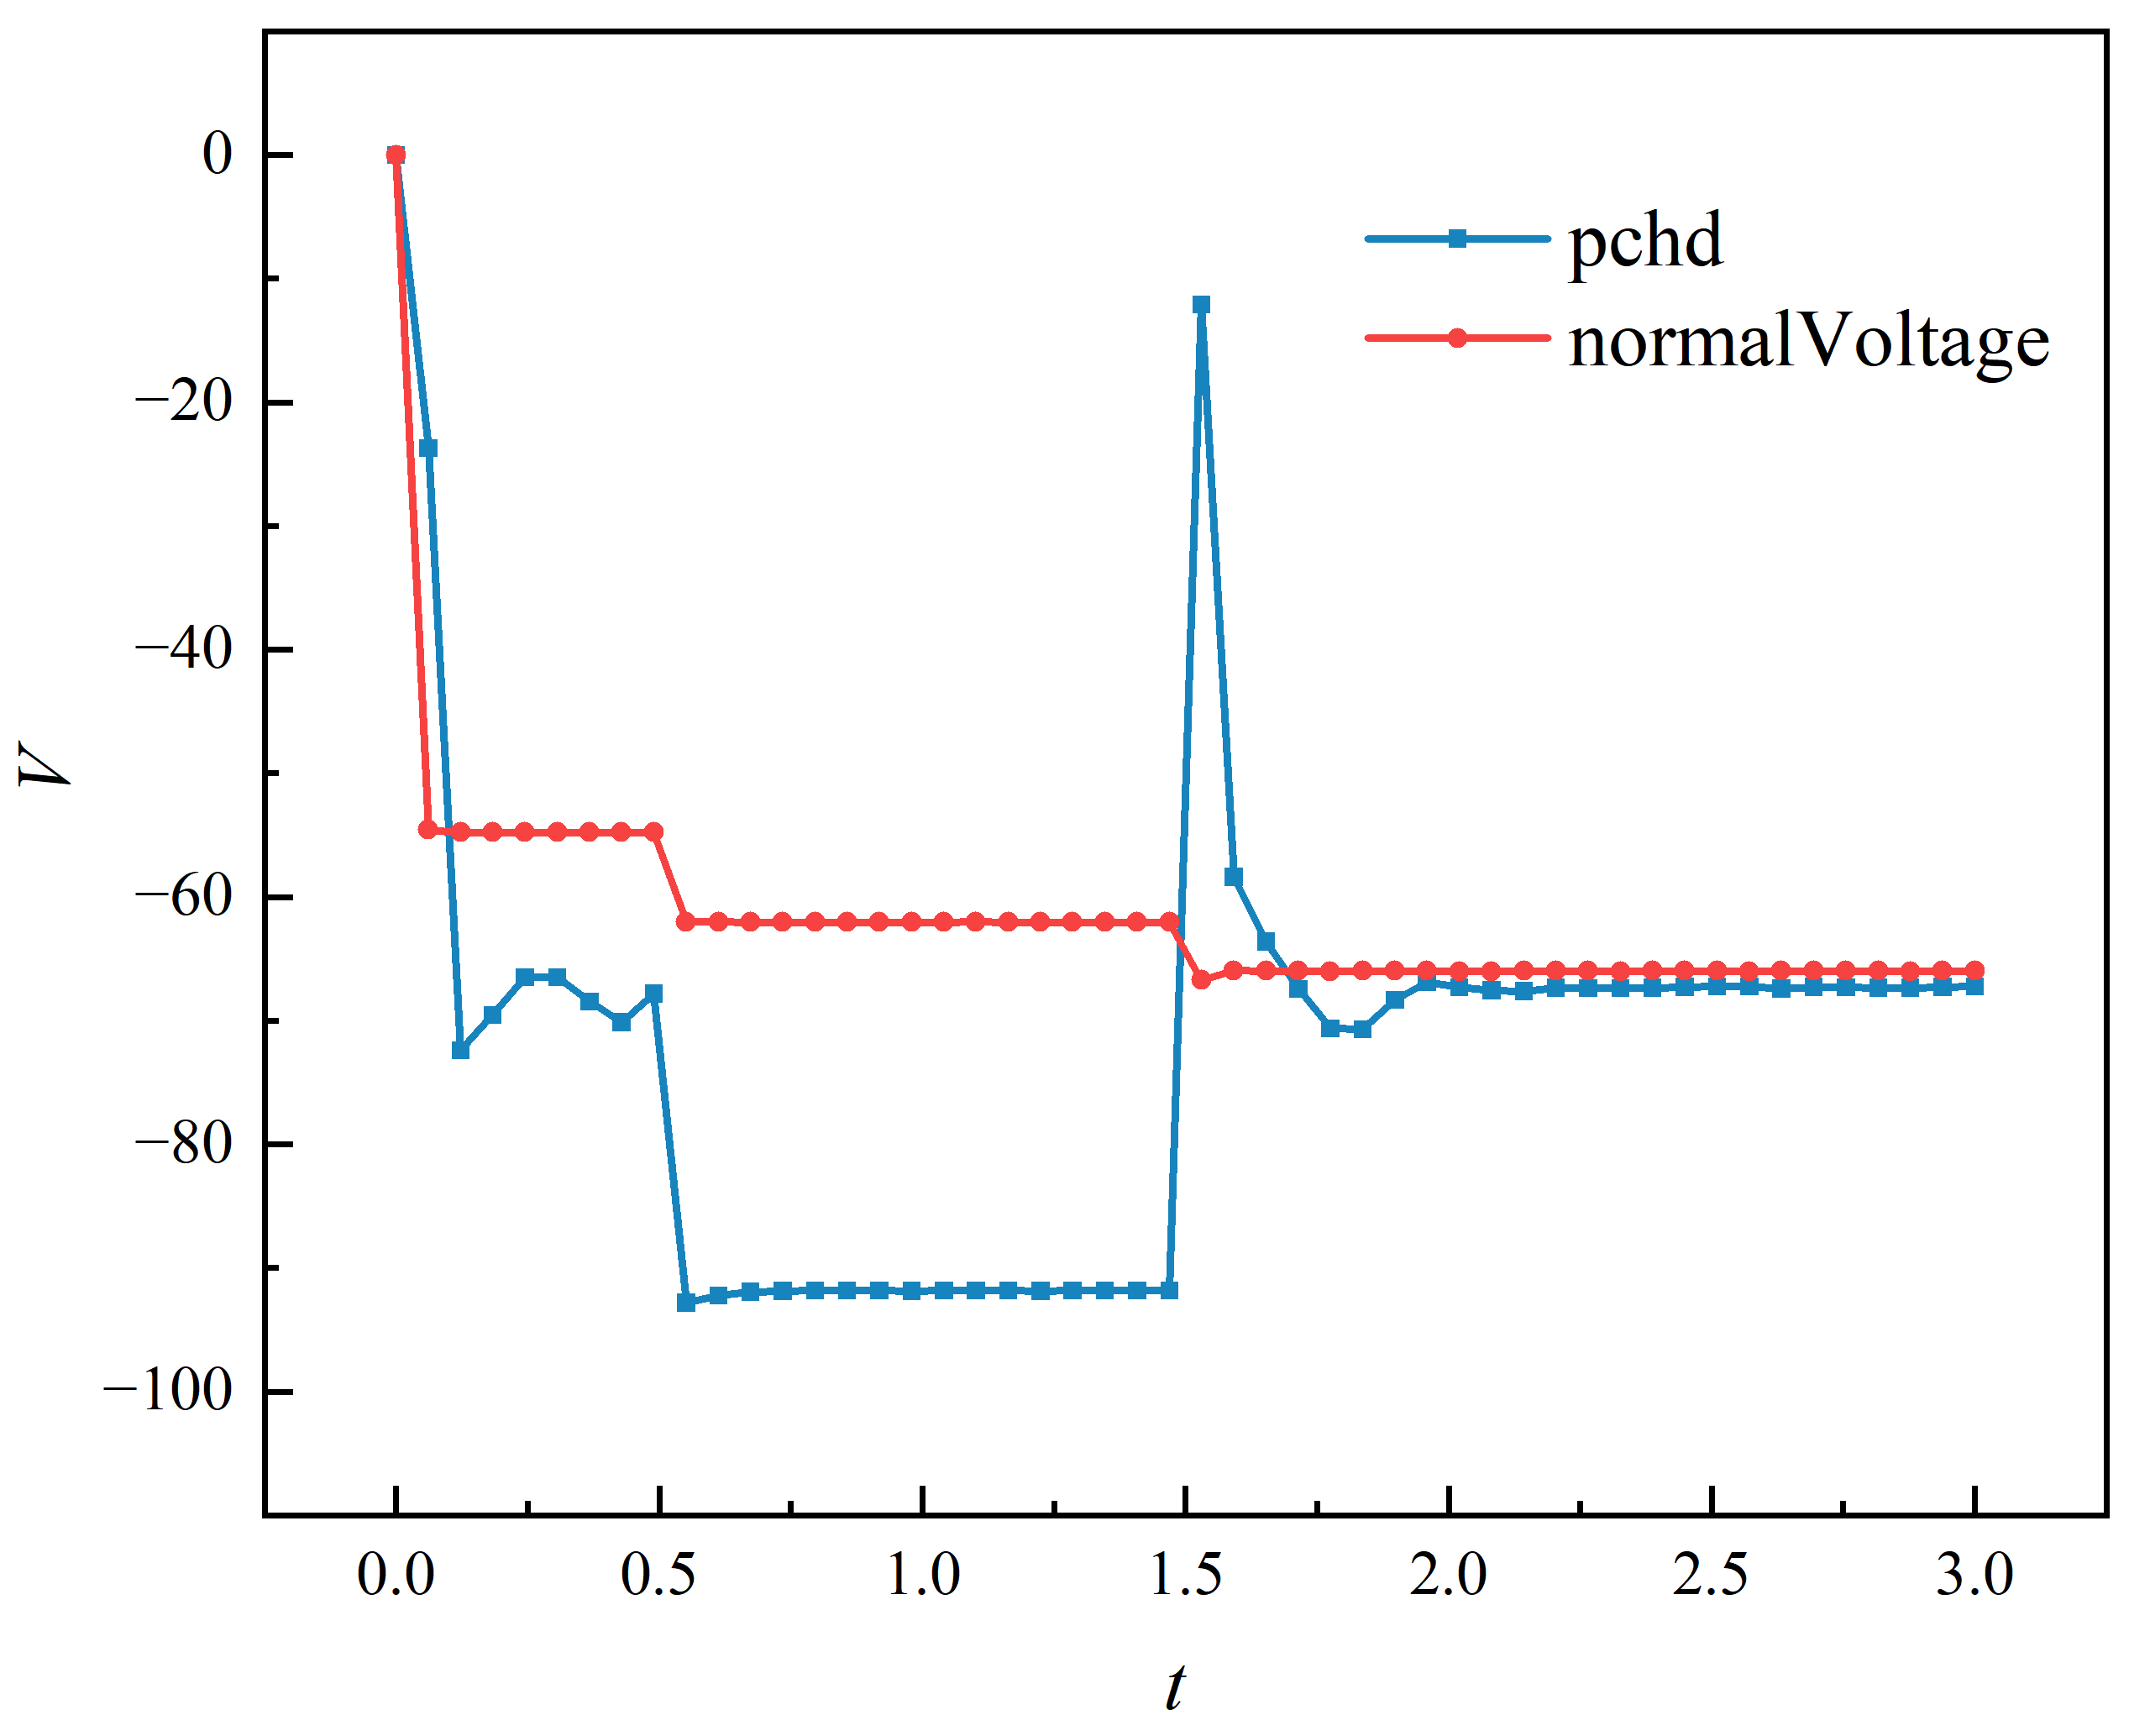

Xin Li1, Qiong Li1*, Hai Yao1, Zijian Wang1
Key Laboratory of Rural Energy Engineering in Yunnan Province, Yunnan Normal University, Kunming 650500, PR China, liqiong@ynnu.edu.cn
A Robust MPPT Framework for Photovoltaic Direct-Drive Thermal Systems Overcoming RHPZ Dynamics
Introduction
$D=1−\frac{V_{pv}+R_{a}\left(i_{L1}−i_{ref}\right)}{Vc1}$ （1）
In photovoltaic (PV) direct-drive thermal-load systems, maximizing energy yield under variable irradiance conditions is a key requirement for practical operation. In this context, the choice of the DC-DC interface is critical. Compared with Buck, Boost, and conventional Buck-Boost converters, the Cuk converter combines step-up/step-down capability with continuous input current, making it more suitable for PV-side energy extraction and dynamic operating-point regulation [1–3].
However, under dynamic irradiance conditions, the operating point of a PV-Cuk system may easily deviate from its desired region. Although standard control strategies are easy to implement, they usually have limited dynamic regulation capability during irradiance transients. To address this issue, this paper investigates a PCHD-inspired indirect current control (ICC) dual-loop strategy, in which the outer loop generates the reference current iref, while the inner loop regulates the current channel. Its operating performance under irradiance disturbances and parameter deviation is then analyzed.
where R_{adenotes} is the damping-related coefficient.
To illustrate the controlled plant, a PV-Cuk circuit model is further established in Simulink. The model includes the photovoltaic array, the main Cuk power stage, and the load, and is used to analyze the dynamic response of the system under irradiance disturbances.
Meanwhile to, to verify the effectiveness of the proposed control strategy, simulation studies are carried out under step irradiance conditions. The irradiance input follows a piecewise profile of step irradiance changes (600 → 1000 → 600 W/m²), which is used to emulate a typical sudden irradiance variation. In addition, input-inductor parameter-deviation cases are further introduced in order to compare the stability and robustness of the circuit under the same irradiance condition
    good robustness of the proposed dual-loop control. When L_1decreases by 20%, the peak inductor current increases from 14.2 A to 14.6 A, i.e., by about 2.8%. When L_1increases by 20%, the peak current slightly decreases to 14.1 A, i.e., by about 0.7%. These results indicate that moderate parameter perturbations cause only minor dynamic-current variations, while the steady-state output is well preserved.
    Tab. 1. Effect of input-inductor deviation on current peak and steady-state output
L₁(uH） | I _{(Low-ir )} | I_{(High-ir)} | Remark
376 | 9.1 A | 14.6 A | higher
470 | 8.9 A | 14.2 A | nominal
564 | 8.8 A | 14.1 A | lower
Conclusions
Methodology
    This paper investigated a PCHD-inspired ICC dual-loop control strategy for a PV-Cuk system in photovoltaic direct-drive thermal-load applications. The results show that the proposed method provides a higher output-voltage level in the high-irradiance stage and preserves nearly unchanged steady-state output under ±20%input-inductor deviation, indicating good robustness. These results suggest that the proposed strategy can improve stable energy delivery for PV direct-drive thermal systems. Moreover, the present work provides a basis for future studies on RHPZ dynamics and their influence on transient MPPT behavior in PV-Cuk systems. This paper investigated a PCHD-inspired ICC dual-loop control strategy for a PV-Cuk system under irradiance disturbances. The results show that the proposed method achieves a higher output voltage in the high-irradiance stage and exhibits more reasonable operating-point regulation. In addition, ±20% input-inductor deviation causes little change in the steady-state output, indicating certain robustness of the proposed structure. Overall, the results verify the effectiveness of the proposed dual-loop strategy for dynamic regulation of PV-Cuk systems.
    The investigated system consists of a photovoltaic source, a Cuk converter, and a load, and a dual-loop control structure is adopted. The outer loop generates the reference current iref according to the PV-side operating condition, while the inner loop regulates the duty ratio through the input inductor current Il1. In this way, the reference-generation task and the duty-ratio regulation task are separated, which improves the control flexibility under irradiance transients. The inner-loop controller is designed in an ICC form, with the input inductor current Il1 selected as the main regulation channel.
Fig. 2. Simulink model of the PV-Cuk circuit.
Result
    Under step irradiance changes (600→1000 → 600 W/m²), the output responses of the standard(normal) control and the proposed PCHD-inspired dual-loop control are compared in Fig. 3. Both methods can restore steady operation after irradiance transitions, while the proposed method achieves a larger output-voltage magnitude in the high-irradiance stage, indicating stronger output capability.
References
Fig.1 Control framework and PV-to-thermal energy flow of the proposed direct-drive thermal-load system.
[1] A. H. R. Rosa, L. M. F. Morais, G. O. Fortes, and S. I. Seleme Júnior, “Practical considerations of nonlinear control techniques applied to static power converters: A survey and comparative study,” International Journal of Electrical Power & Energy Systems, vol. 127, p. 106545, 2021.
[2] H. Phillips-Brenes, M. Muñoz-Arias, R. Pereira-Arroyo, L. M. Esquivel-Sancho, and R. Rimolo-Donadio, “Passivity-Based Control Approach for Photovoltaic DC-DC Conversion and Output Voltage Regulation,” IEEE Transactions on Control Systems Technology, vol. 33, no. 2, pp. 479–492, 2025.
[3] M. Sadeghi and R. Havangi, “Robust adaptive PID controller for maximum power point tracking in photovoltaic systems under uncertainty,” Solar Energy, vol. 310, p. 114477, 2026.
    The inner-loop controller is designed in an ICC form, with the input inductor current i_L1selected as the main regulation channel and the outer-loop current i_reftaken as the target trajectory. This structure is consistent with the PCHD/passivity-inspired idea of regulating the main current channel. Accordingly, the duty ratio is given byInspired by the PCHD/passivity-based control idea, the duty ratio is determined by the current tracking error together with the key state variables. A simplified control law is given by
Fig.3.Vout under different conditions.
    To evaluate the effect of input-inductor deviation, additional simulations are carried out with L_1varied within ±20%of its nominal value, as listed in Tab. 1. The steady-state output voltage remains nearly unchanged in all cases, indicating

