Slide 1


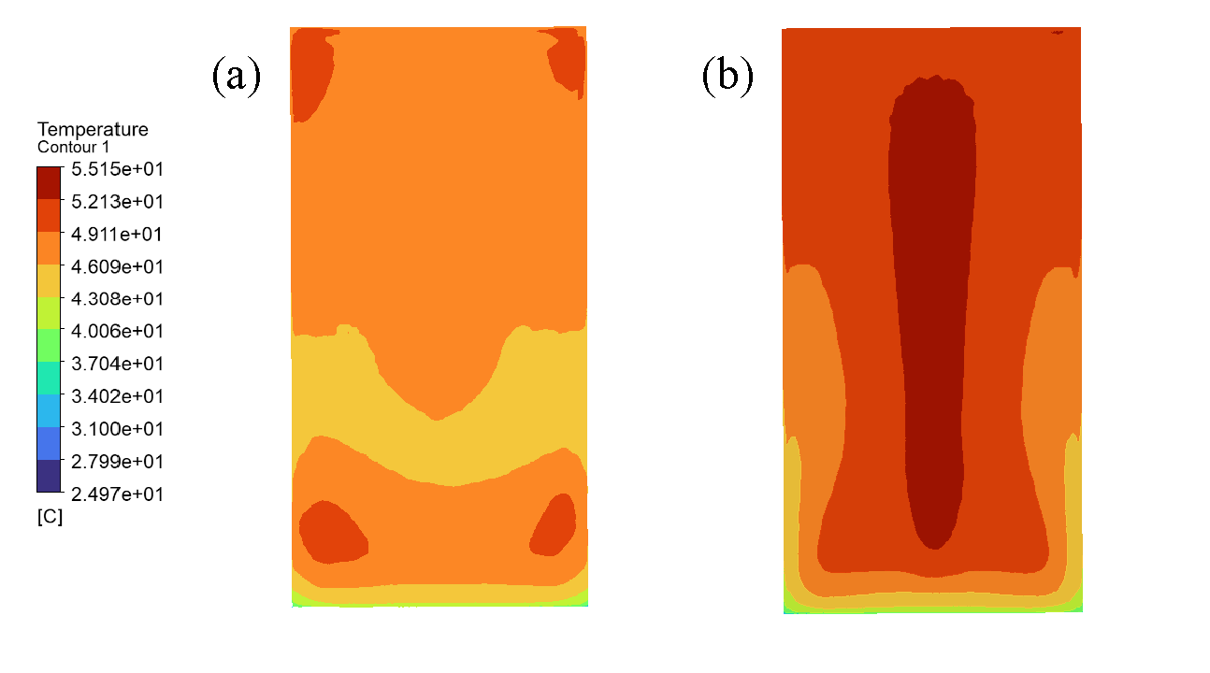
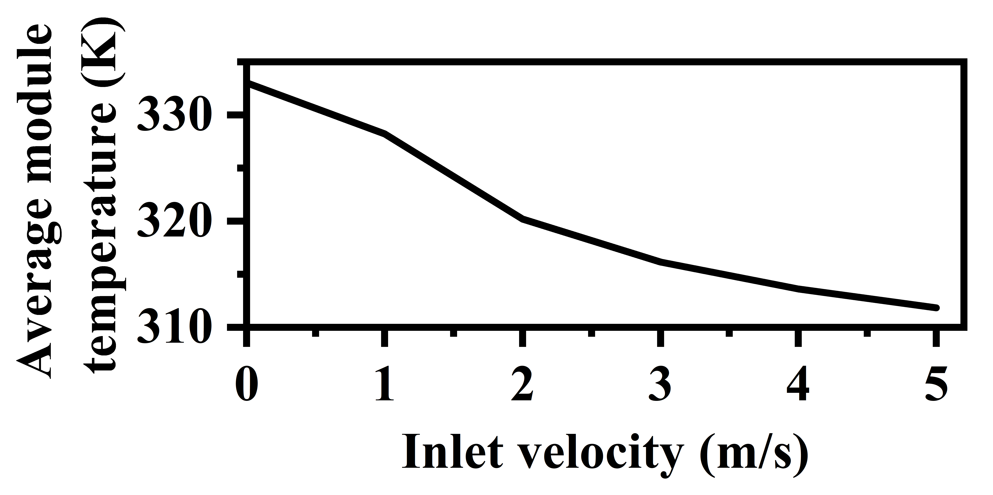
Qiwei Gao, Qiong Li*, Zijian Wang, Hai Yao
Key Laboratory of Rural Energy Engineering in Yunnan Province, Yunnan Normal University, Kunming 650500, PR China, liqiong@ynnu.edu.cn
CFD-Informed PPO Control for Active Cooling of Photovoltaic Modules
Introduction
and α = 30°, shows a more uniform temperature field and a lower overall temperature than H = 300 mm and α = 15°. This result shows that posture has a clear effect on heat dissipation.
and an RMSE of 2.1655 K. These results show that the surrogate model can reproduce the main temperature trends and can be used for PPO training.
PV modules operate under changing irradiance and airflow conditions. The resulting temperature rise reduces electrical efficiency and affects system performance. Most existing control methods rely on fixed rules or threshold settings, which are simple but not well suited for dynamic conditions.
Most existing control methods rely on fixed rules or threshold strategies. These methods are simple, but they are often not flexible enough for changing operating conditions. They also do not fully use the thermal regulation potential of module posture.
In this study, thermal regulation is achieved through posture adjustment instead of additional cooling devices. The mounting height and tilt angle are treated as controllable variables. A closed-loop framework combining CFD, surrogate modeling, and PPO is developed to verify the feasibility of posture-based thermal regulation.
PPO training results
The baseline posture, H = 400 mm and α = 30°, is used as the reference in the reward design. Fig. 4 shows that the moving-average episode reward still fluctuates, but the policy no longer collapses to a single boundary action. Under a representative condition, the PPO-predicted posture gives a slightly lower average temperature than the baseline posture, which supports the feasibility of the proposed framework.
Fig.1 Comparison of surface temperature contours of the PV module under different postures.
baseline posture (H=400 mm, α=30°);
(b) comparison posture (H=300 mm, α=15°)
Fig.2 shows the effect of inlet velocity at G = 1000 W/m², H = 400 mm, and α = 30°. As the inlet velocity increases from 0 m/s to 5 m/s, the average module temperature decreases from about 333 K to 312 K. This confirms that stronger airflow enhances convective heat transfer and suppresses temperature rise.
Methodology
The research object is a 113 cm × 228 cm bifacial PV module. A three-dimensional steady photo-electro-thermal CFD model is established to investigate the thermal response under different environmental and posture conditions. The input variables are irradiance G, wind speed v, mounting height H, and tilt angle α. The main output is the average module temperature.
The parameter ranges are G = 400–1000 W/m², v = 0–4 m/s, H = 300–800 mm, and α = 15°–45°. Latin hypercube sampling is used to generate steady-state cases, and 48 valid CFD samples are obtained. Based on these samples, a random-forest surrogate model is trained to predict the average module temperature from (G, v, H, α).
The control problem is formulated as a Markov Decision Process. The state includes the environmental variables and the current posture. The action consists of continuous adjustments of H and α. The baseline posture is set as H = 400 mm, α = 30°. The reward is defined by the temperature improvement relative to this baseline posture, with an additional action-change penalty. The PPO algorithm is then used to learn continuous posture-control policies in the surrogate environment.
Fig.4 Convergence of PPO training
Conclusions
This study develops a CFD-surrogate-PPO framework for posture-based thermal regulation of a bifacial PV module. The surrogate model achieves an R² of 0.8347, with an MAE of 1.6626 K and an RMSE of 2.1655 K. The trained PPO agent can output feasible non-boundary postures, and the predicted average temperature under the learned posture is slightly lower than that under the baseline posture. These results indicate the preliminary feasibility of the proposed framework. It provides a practical basis for future work on larger CFD datasets and improved control design.
Fig.2 Effect of inlet velocity on the average module temperature under the fixed condition.
( G=1000 W/m², H=400 mm, and α=30°)
Surrogate model performance
Fig.3 shows that the random-forest predictions are close to the ideal line y = x. This indicates good agreement with the CFD results. The model reaches an R² of 0.8347, with an MAE of 1.6626 K
References
[1] Jaszczur M, Teneta J, Hassan Q, et al. “An experimental and numerical investigation of photovoltaic module temperature under varying environmental conditions”. In Heat Transfer Engineering, vol. 42, 2021 (3-4), pp. 354-367.
[2] Aghaei M, Korevaar M, Babal P. “Bifacial Photovoltaic Technology: Recent Advancements, Simulation”. In Solar Radiation: Measurement, Modeling and Forecasting Techniques for Photovoltaic Solar Energy Applications, 2022, pp. 167.
Result
Fig.1 compares the surface temperature contours under two postures at G = 1000 W/m² and v = 2 m/s. The baseline posture, H = 400 mm
Thermal dissipation and influencing factors
Fig.3 Surrogate model performance

