Slide 1

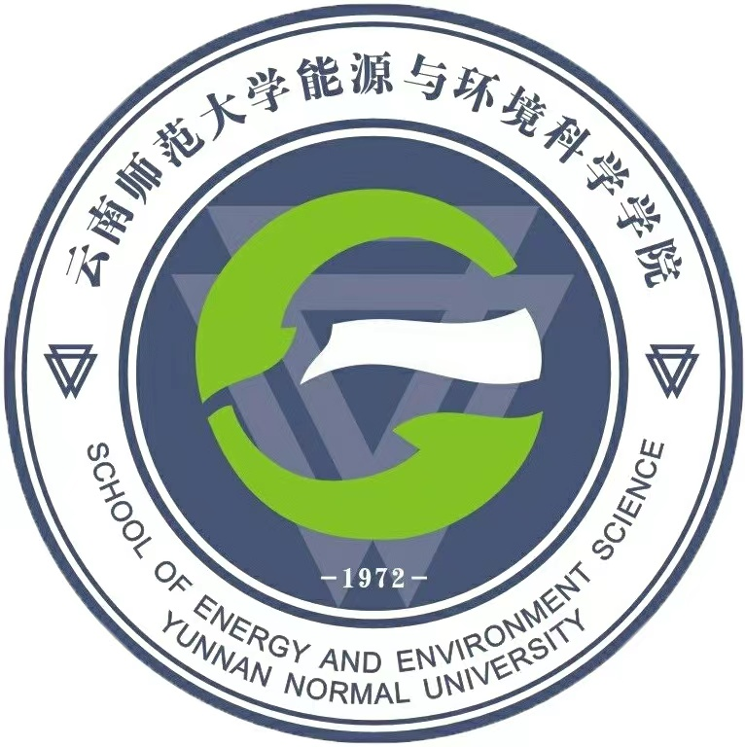
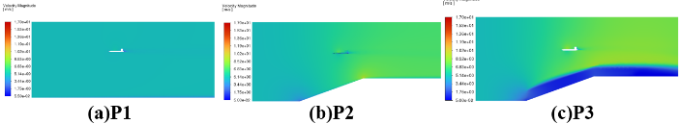
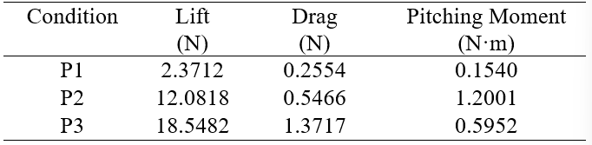
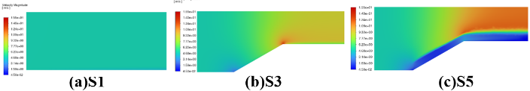
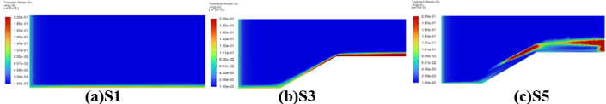
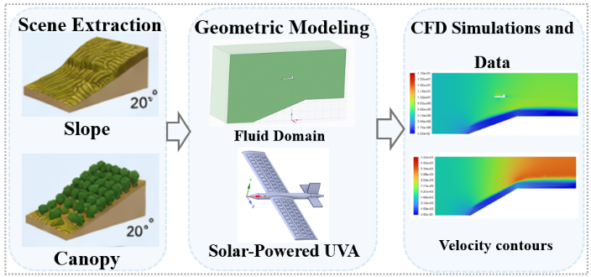
Junyi Zhang¹, Qiong Li^{1*}, Chunyan Luo¹, Jiawei Liu¹
1Key Laboratory of Rural Energy Engineering in Yunnan Province, Yunnan Normal University, Kunming 650500, PR China, liqiong@ynnu.edu.cn
Coupling characteristics of multiphysics fields on the wing surface of solar-powered unmanned aerial vehicles
Introduction
    The porous-medium parameters were kept consistent in all directions, with viscous and inertial resistance coefficients set to 1000 and 10, respectively, to represent the canopy's blocking and dissipative effects. The UAV height was fixed at 3.043 m to maintain geometric consistency, and representative complex flow-field cases were selected to assess their impact on the UAV's velocity distribution, lift, drag, and pitching moment.
Solar-powered unmanned aerial vehicles (UAVs) are widely used in agricultural inspection due to their long endurance and low-carbon features. While integrating solar cells improves endurance and efficiency, external disturbances impact flight performance [1,2]. In particular, the complexity and non-uniformity of near-ground flow fields are further intensified by terrain and vegetation, by which the risk of instability during low-altitude flight is increased. This study explores the coupling effects of slope, canopy, and solar-powered UAVs, analyzing the influence of near-ground flow fields on aerodynamics.
Fig.4 Velocity contours on the central longitudinal plane (z = 0) with the solar-powered UAV under different terrain and canopy conditions
    Table 1 summarizes the aerodynamic loads of the solar-powered UAV under different flow-field conditions. As environmental complexity increases, the aerodynamic loads are markedly increased. Under steep-slope conditions, lift, drag, and pitching moment are increased by 409.52%, 114.02%, and 679.29%, respectively. After the canopy is introduced, lift and drag are further increased by 53.52% and 150.96%, respectively, whereas pitching moment is reduced by 50.40%. These variations are mainly caused by terrain- and canopy-induced inflow distortion, which strengthens flow non-uniformity and local pressure redistribution around the UAV, thereby increasing aerodynamic penalties and longitudinal sensitivity.
Result
Methodology
    Fig. 2 compares the velocity contours on the central longitudinal plane (z = 0) at 5 m/s under different terrain and canopy conditions. The near-ground flow is shifted from a relatively uniform state to a non-uniform one. Velocity redistribution is mainly induced by the slope, while stronger deceleration, broader low-velocity zones, and larger gradients are caused by the canopy. These features result from terrain adjustment and canopy drag and blockage, which weaken momentum transport and enhance flow heterogeneity.
    Given the sensitivity of low-altitude solar-powered UAV operations in agricultural environments to complex disturbances, a solar-powered UAV model with a 2 m wingspan and a 1 m fuselage length was developed based on the E387 airfoil, which is characterized by a favorable lift-to-drag ratio, aerodynamic stability, and suitability for solar-cell integration. In addition, to improve computational efficiency, the 0.3 mm solar film was simplified as surface partitions on the wing. A computational domain of 12 m × 5 m × 6 m was defined to provide sufficient space for flow development over complex terrain and to effectively suppress the influence of boundary effects on the numerical results.
    As illustrated in Fig. 1, 3D models of the solar-powered UAV and its environment were established, and computational fluid dynamics (CFD) simulations were conducted to investigate the effects of complex flow fields on the aerodynamic response of the solar-powered UAV. The key variables were slope and canopy, with environmental conditions defined as S1 (flat, no canopy), S2 (20°, no canopy), S3 (30°, no canopy), S4 (20°, with canopy), and S5 (30°, with canopy), and UAV response conditions defined as P1 (flat, no canopy), P2 (20°, no canopy), and P3 (20°, with canopy).
Tab.1 Aerodynamic Performance of the solar-Powered UAV under Different Conditions
Fig.2 Velocity contours on the central longitudinal plane (z=0) under different terrain and canopy conditions
Conclusions
    Fig. 3 presents the turbulent kinetic energy(TKE) contours on the central longitudinal plane (z = 0) at 5 m/s under the same conditions as in Figure 2. The near-ground flow is shifted to a more turbulent state by the slope and canopy. TKE is increased by the slope and further intensified by the canopy. This is caused by terrain adjustment and canopy drag and blockage, which enhance shear and turbulence generation.
    It is revealed that the aerodynamic behavior of solar-powered UAVs in mountainous tea gardens is strongly affected by near-ground flow distortion caused by terrain and canopy. Inflow heterogeneity and aerodynamic penalties are significantly enhanced, with the load increase being mainly induced by the slope and the drag amplification and pitching moment variation being further intensified by the canopy. It is therefore suggested that complex near-ground environmental effects should be fully considered in the aerodynamic design, flight stability assessment, and energy management of low-altitude agricultural UAVs.
Fig.3 Turbulent kinetic energy contours on the central longitudinal plane (z=0) under different terrain and canopy conditions
References
    Under different terrain and canopy conditions, the velocity contours on the central longitudinal plane (z = 0) with the solar-powered UAV at 5 m/s are compared in Fig. 4. The velocity field around the UAV is made more non-uniform by the slope and canopy. Stronger low-velocity regions, larger local gradients, and more pronounced wake disturbances are induced under complex conditions. This is attributed to upstream flow distortion and strengthened local flow interaction.
Fig.1 Technology Roadmap
[1] Gencag M S, Dalkiran F Y, Kekec E T, et al. Impact analysis of solar cells on fixed-wing UAV: simulation-based performance evaluation under varying environmental conditions. The Aeronautical Journal, 2026: 1-24.
[2] Jia W, Zhou Z, Lei T, et al. Real-time energy optimization of Solar powered UAVs under wind and cloud disturbances. Aerospace Science and Technology, 2026, 176(B): 112201.
    All cases were computed under steady-state conditions using a pressure–velocity coupled solver, the realizable k−ε turbulence model, and the SIMPLE algorithm. The tea canopy was simplified as an equivalent porous zone with a height of 0.6 m to focus on the effects of terrain and canopy on near-ground flow evolution.

