Slide 1


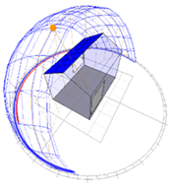
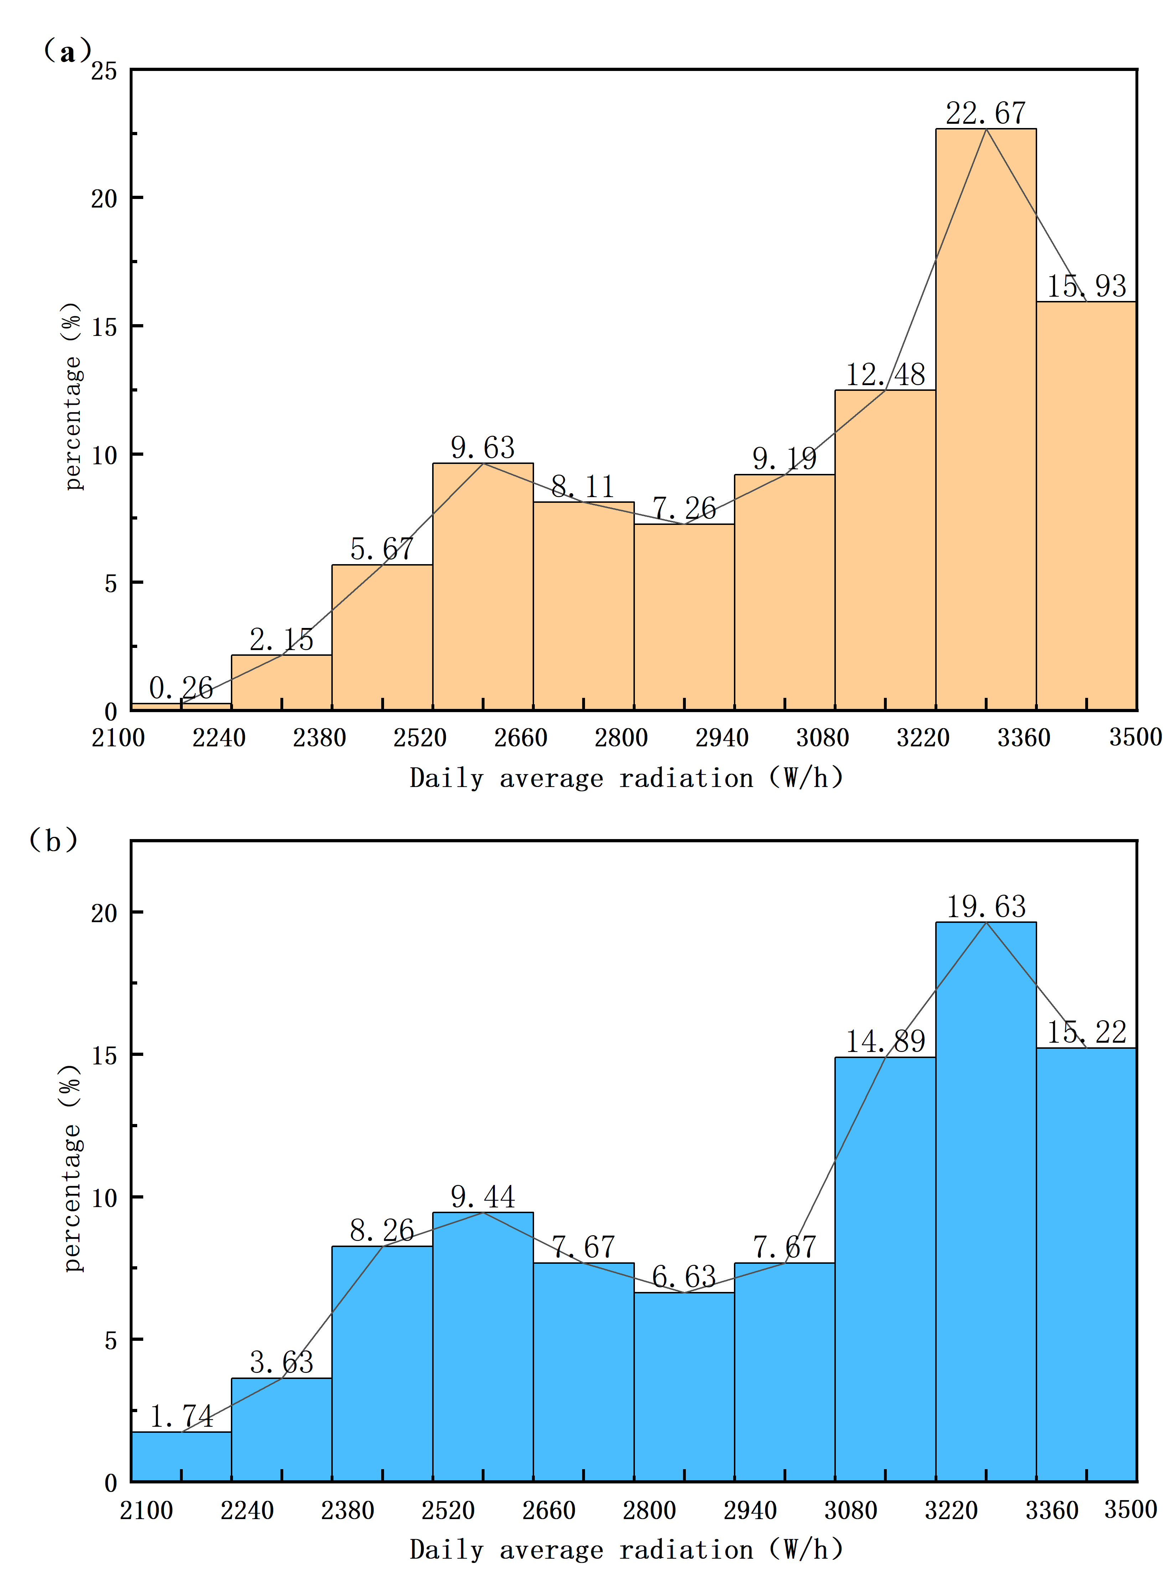
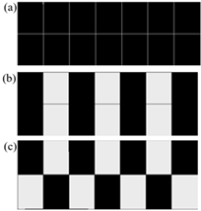
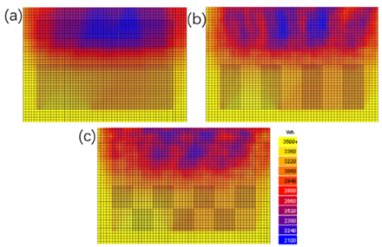
Chunyan Luo¹, Qiong Li^{1*}, Junyi Zhang¹, Jiawei Liu¹
Key Laboratory of Rural Energy Engineering in Yunnan Province, Yunnan Normal University, Kunming 650500, PR China, liqiong@ynnu.edu.cn
Patterns of Microenvironmental Evolution in Photovoltaic Greenhouses Under Dynamic Solar Irradiance Conditions
Introduction
modules was simplified, and the solar panels were modeled as rectangular prisms with corresponding material properties.
Fig. 4 shows the effect of average daily irradiance on the shading area ratio for the checkerboard and staggered layouts. Both layouts have similar radiation distribution trends, peaking at 3320–3360 W/h. The checkerboard layout has 22.7% of nodes in this range, slightly higher than the 20.0% for the staggered layout. In the low-irradiation range (2100–2240 W/h), the checkerboard layout has only 0.3% of nodes, much lower than the 1.7% for the staggered layout. This demonstrates that the checkerboard layout reduces low-irradiation zones and increases high-irradiation zones, leading to more uniform radiation and higher overall intensity.
Solar radiation is the primary energy source for greenhouses and has a significant impact on the indoor lighting environment. The type and layout of photovoltaic (PV) modules on greenhouse roofs directly determine the distribution of indoor radiation^{[1]}. Although the installation of PV panels can improve power generation efficiency, it may result in insufficient light exposure for crops. Studies have shown that a checkerboard layout of PV panels is more effective in improving radiation uniformity than linear or staggered layouts^{[2]}. However, there remains a lack of in-depth research on the evolution of low-radiation shadow zones under dynamic solar irradiation conditions, particularly during winter when the sun’s angle of elevation is low. Taking a small-scale photovoltaic greenhouse in a low-latitude, high-altitude region as a case study, this study simulates and analyzes the characteristics of indoor radiation distribution under three installation patterns (full coverage, staggered, and checkerboard) during winter, providing a basis for optimizing the layout of photovoltaic greenhouses.
Fig.2.Model Development
Relevant meteorological data for Kunming, including parameters such as air temperature, relative humidity, total radiation, diffuse radiation, and wind speed and direction, were loaded using the software’s meteorological database tool. The model is shown in Fig. 2. The optical properties of the greenhouse’s primary materials are listed in Tab.1. A uniform grid of 60 × 35 cells was defined in the top-down cross-section. Simulations were conducted for the entire winter season in Kunming (8:00–16:00) to analyze the variation in average daily solar radiation within the greenhouse.
Table. 1. Material Properties
Methodology
The small-scale photovoltaic greenhouse studied in this research is located in Kunming, Yunnan Province (102.87°E, 24.97°N). The region has a subtropical plateau monsoon climate, characterized by a warm and humid climate with spring-like conditions year-round. The annual average temperature is 15.6°C, the average annual precipitation is approximately 818.4 mm, and the average annual sunshine duration is approximately 2,100 hours.
The photovoltaic greenhouse has east-west orientation, measuring 5 m in length, 3.5 m in width, and 3 m in height, with a single-ridge, double-sloped roof. Photovoltaic panels are installed on the southern roof at a 30° angle, arranged in three patterns: dense (100% coverage), staggered (57% coverage), and checkerboard (50% coverage) (Fig. 1). Each panel measures 1080 mm × 710 mm × 30 mm. The north roof and perimeter walls are covered with 0.1 mm anti-aging polyolefin film (92% light transmittance), and windows on the south and north walls have a 35% window-to-wall ratio.
Material | Absorption (%) | Transmittance (%) | Reflectance (%)
Solar panel | 73 | 0 | 17
Greenhouse film | 6 | 92 | 2
Floor | 46 | 0 | 53
Result
Fig. 3 shows the solar radiation distribution on the greenhouse floor (average irradiance from 8:00 a.m. to 4:00 p.m. daily from December to February). The dense layout results in larger low-irradiation zones, mainly on the north-facing roof, with a minimum intensity of 1,400 W/h, causing uneven radiation. In contrast, the checkerboard and spaced layouts improve uniformity by reducing shadow areas (minimum intensity of 2,100 W/h), which is due to better panel spacing that minimizes shading and improves light distribution.
Fig. 4. Distribution of average daily irradiance under different layout patterns: (a) Checkerboard, (b) Spaced
Conclusions
(1) Under winter conditions with a low sun angle, solar radiation intensity on the north-facing roof of a photovoltaic greenhouse is generally lower than on the south-facing roof; the layout of the photovoltaic panels has a significant impact on the distribution of indoor radiation.
(2) The checkerboard layout provides the most even shading, resulting in higher overall radiation intensity than the staggered layout; it is the most effective layout among the three for improving the greenhouse’s light environment.
References
[1] Li Tianyu, Sun Yaojie, Wu Jialu, et al. Effect of Photovoltaic Module Layout on Solar Utilization in Greenhouse Roofs [J]. Journal of Lighting Engineering, 2022, 33(06): 195–202.
[2] Fatnassi H ,Poncet C ,Bazzano M M , et al.A numerical simulation of the photovoltaic greenhouse microclimate[J].Solar Energy,2015,120575-5
Fig.1. Three types of photovoltaic module layout. (a) Full coverage (b) Spaced (c) Checkerboard
This study used Ecotect software to create a 1:1 scale greenhouse model for modeling and analysis. The complex structure of the photovoltaic
Fig. 3. Distribution of winter surface solar radiation. (a) Solid coverage; (b) Spaced coverage; (c)Checkerboard pattern

