Slide 1
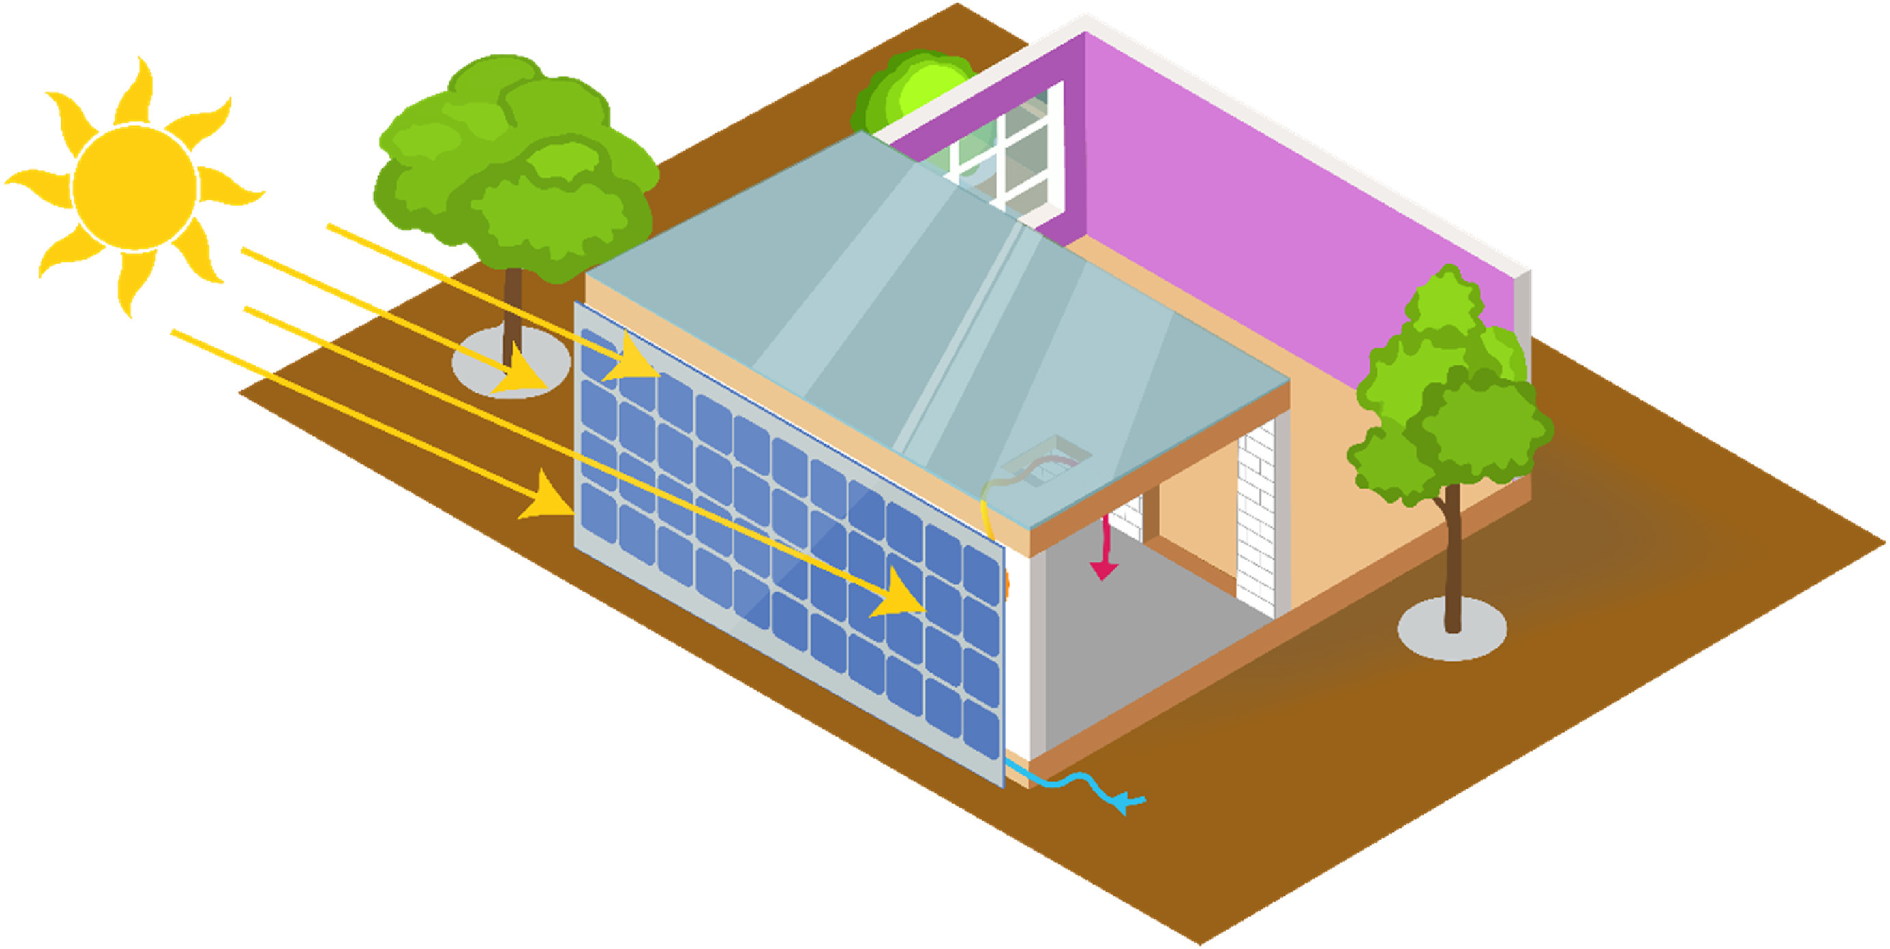
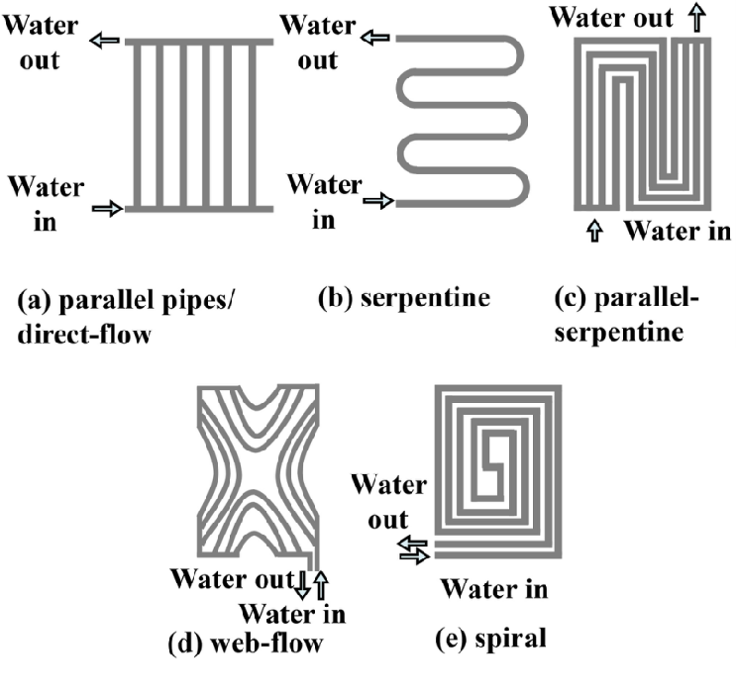
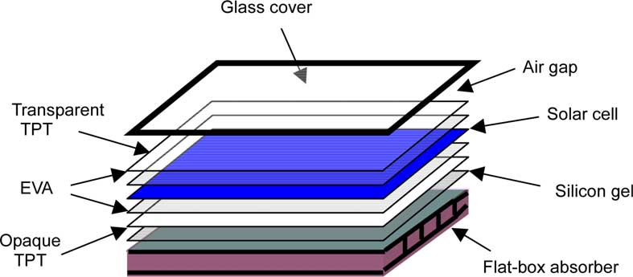
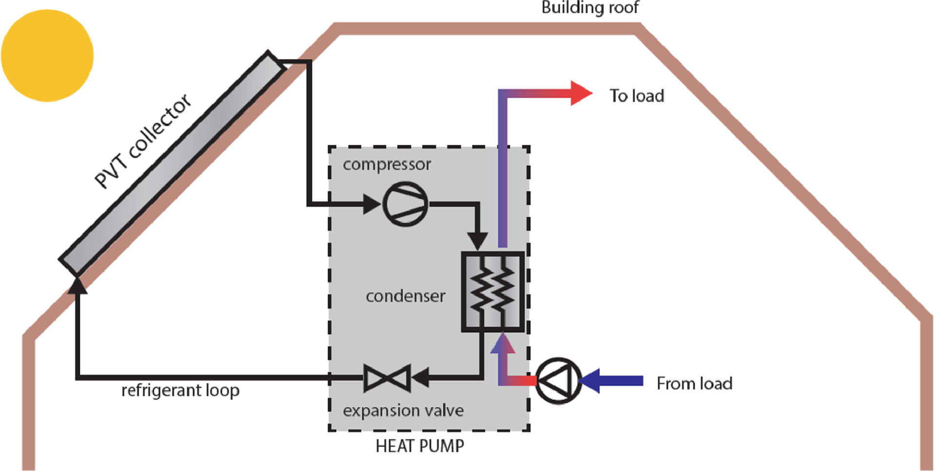
A Review of Photovoltaic/Thermal (PV/T) Technology: Recent Progress and Future Application
Z. Jiang
Department of Energy and Mechanical Engineering, SUEP, Shanghai, China
Z. Fu
Department of Energy and Mechanical Engineering, SUEP, Shanghai, China
Introduction
tube, and microchannel heat exchangers, the fluid flow paths are illustrated in Fig.2. Dual-circulation PV/T collectors combine air- and water-cooled technologies, making them suitable for regions with significant temperature variations.
The choice of heat transfer medium in a PV/T system also profoundly influences system performance. Common mediums include air, water, refrigerants, and nanofluids. Compared to air, water-cooled PV/T systems exhibit superior electrical generation efficiency. Refrigerants are primarily utilized in PV/T-heat pump systems to enhance energy efficiency through phase change processes such as evaporation and condensation. Nanofluids enhance the thermal conductivity of the working fluid by incorporating nanoparticles, making them a focal point in recent PV/T research.
with building envelopes to maximize the utilization of solar radiation (see Fig.4). In distributed clean heating systems, PV/T collectors are coupled with heat pumps, making them suitable for space heating and domestic hot water supply. In solar desalination, PV/T systems utilize seawater for cooling PV panels while simultaneously heating the water to enhance freshwater production. In addition, PV/T technology demonstrates significant potential in several emerging application areas, as illustrated in Table 1.
In comparison to traditional fossil energy sources, solar energy offers significant advantages, including cleanliness, renewability, and wide availability. As global energy demand continues to rise and fossil fuel consumption intensifies, the development of efficient solar energy utilization technologies is increasingly regarded as a key solution to the energy crisis. Solar energy utilization primarily comprises photovoltaic (PV) and photothermal (PT) conversions, which are highly complementary, thereby establishing photovoltaic/thermal (PV/T) integration as a major focus of current research.
PV/T technology combines photovoltaic power generation with solar thermal utilization, thereby enhancing the comprehensive efficiency of solar energy use. The core component of the system is the PV/T collector, which typically consists of glass cover, encapsulation layer (EVA), solar cell, tedlar, heat-absorbing plate, and fluid channels, as shown in Fig.1. The PV/T collector not only directly converts solar radiation into electricity but also efficiently removes the excess heat through the cooling medium circulating in the flow channels behind the photovoltaic module. This heat can be reused for space heating, domestic hot water, or industrial applications [1]. This dual utilization not only reduces the operating temperature of the PV cells but also simultaneously recovers waste heat, thereby significantly enhancing the overall efficiency of solar energy utilization. Based on the use of concentrating technology, PV/T collectors can be classified into flat-plate and concentrating types [2], while according to the type of cooling medium, they are categorized as air-cooled, water-cooled, or refrigerant-cooled systems.
Fig. 4. Schematic diagram of BIPV/T [9].
Table 1. Other applications of PV/T technology.
Researchers | Applications | Research contents
Wang et al. [10] | solar cooling | constructed a PV/T integrated absorption refrigeration system with an optimal total energy efficiency of 88.26% in summer CPCH mode.
Sajid et al. [11] | solar greenhouse | compared four PV/T-driven greenhouse systems, and the system containing nanofluids had lower cost.
Shi et al. [12] | solar hydrogen production | combined PV/T with PEMWE to form a hydrogen production system, which had a hydrogen production efficiency 14% higher than conventional PV-PEMWE.
Fig. 2. Common water-cooled PV/T collector runner designs [6].
3. Studies of PV/T coupled systems
In addition to research on the PV/T system itself, it can be coupled with other technologies to improve the performance of the system. The PV/T-heat pump system integrates a PV/T collector with a heat pump to efficiently recover waste heat from PV modules and elevate it to a usable temperature, while simultaneously generating electricity to power the heat pump, thereby enhancing overall energy utilization. As shown in Fig.3, this system can achieve a comprehensive efficiency of 60%-80%, and is widely applied in heating, cooling, domestic hot water, and other energy demand scenarios. PV/T-PCM systems incorporate a PCM layer attached to the rear of the PV module [7], which stores excess heat during the daytime and releases it at night or under low solar irradiation to maintain stable thermal output. This integration significantly improves power generation, thermal efficiency, and system reliability, making it well-suited for distributed energy systems and building heating applications.
Conclusions
PV/T technology has made remarkable progress in both research and practical applications, demonstrating substantial potential for future development. Continued innovation and optimization in photovoltaic materials, fluid channel structures, nanoparticles, and phase change materials can further overcome technical and economic barriers, thereby enhancing the role of PV/T systems in the global energy transition.
Fig. 1. Schematic diagram of PV/T collector composition [3].
Research progress of PV/T technology
1.Electrical studies of PV/T systems
Crystalline silicon-based PV/T systems mainly use monocrystalline and polycrystalline silicon solar cells, which currently dominate the photovoltaic market. Monocrystalline silicon cells offer high conversion efficiency and stability, accounting for over 70% of the market share [4]. In contrast, polycrystalline silicon cells are more cost-effective and easier to manufacture but have lower conversion efficiency. Thin-film PV/T systems, which mainly use amorphous silicon and compound thin-film solar cells, offer excellent low-light performance and flexibility, making them well-suited for applications such as building-integrated PV/T (BIPV/T) systems. Typical compound thin-film cells include cadmium telluride (CdTe), copper indium gallium selenide (CIGS), and gallium arsenide (GaAs) devices.
2.Thermal studies of PV/T systems
Optimizing the fluid channel structure of PV/T collectors significantly enhances heat transfer efficiency. Air-cooled PV/T collectors can achieve a thermal efficiency improvement of up to 73.1% by refining channel geometry [5]. The water-cooled PV/T collector is the most widely adopted configuration, featuring typical designs such as flat plate, serpentine
References
[1] D. Dong, H. Qin, C. Liu, X. Jin. Research progress in solar photovoltaic/thermal (PV/T) technology. Chemical Industry and Engineering Progress 32(5), 1020-1024 (2013).
[2] Y. Xiao, W. Niu, G. Wei, L. Cui, X. Du. Review on Research Status and Developing Tendency of Solar Photovoltaic/Thermal Technology. Power Generation Technology 43(3), 392-404 (2022).
[3] W. He, T. T. Chow, J. Ji, J. Lu, G. Pei, Lok-shun Chan. Hybrid photovoltaic and thermal solar-collector designed for natural circulation of water. Applied Energy 83, 199-210 (2006).
[4] Y. Li, T. Zhang, H. Zhang, P. Cui, Z. Fu, Z. Gao, Q. Geng, Z. Liu, Q. Zhu, H. Li, M. Li. Efficient and Comprehensive Photovoltaic/Photothermal Utilization Technologies for Solar Energy. Power Generation Technology 43(3), 373-391 (2022).
[5] Z. Lu, Z. Kang, M. Li. Optimization analysis of air-cooled PV/T collector channel structure. Renewable Energy Resources 38(12), 1597-1603 (2020).
[6] A. Fudholi, K. Sopian, M. H. Yazdi, M. H. Ruslan, A. Ibrahim, H. A. Kazem. Performance analysis of photovoltaic thermal (PVT) water collectors. Energy Conversion and Management 78, 641-651 (2014).
[7] Z. Fu, X. Liang, Y. Li, L. Li, Q. Zhu. Performance improvement of a PVT system using a multilayer structural heat exchanger with PCMs. Renewable Energy 169, 308-317 (2021).
[8] A. Miglioli, N. Aste, C. D. Pero, F. Leonforte. Photovoltaic-thermal solar-assisted heat pump systems for building applications: Integration and design methods. Energy and Built Environment 4(1), 39-56 (2023).
[9] A. Sohani, C. Cornaro, M. H. Shahverdian, M. Pierro, D. Moser, S. Nižetić, N.r Karimi, L. K. B. Li, M. H. Doranehgard. Building integrated photovoltaic/thermal technologies in Middle Eastern and North African countries: Current trends and future perspectives. Renewable and Sustainable Energy Reviews 182, 113370 (2023).
[10] P. Wang, Q. Li, S. Wang, B. Hui. A multi-generation system with integrated solar energy, combining energy storage, cooling, heat, and hydrogen production functionalities: Mathematical model and thermo-economic analysis[J]. Renewable Energy, 2024,230:120812.
[11] M. U. Sajid, Y. Bicer. Comparative life cycle cost analysis of various solar energy-based integrated systems for self-sufficient greenhouses[J]. Sustainable Production and Consumption, 2021,27:141-156.
[12] Z. Shi, C. Weng, J. Cai, T. Zhang. Study on dynamic performance of PV/T based on proton exchange membrane water electrolysis system[J]. Acta Energiae Solaris Sinica, 2023,44(8):164-170.
Fig. 3. Structure of the PV/T-heat pump system [8].
Application areas of PV/T
technology
PV/T technology enables the simultaneous generation of electrical and thermal energy, making it highly applicable across various sectors, including buildings, industrial heating, and modern agriculture. In BIPV/T applications, PV/T collectors are integrated

