Slide 1
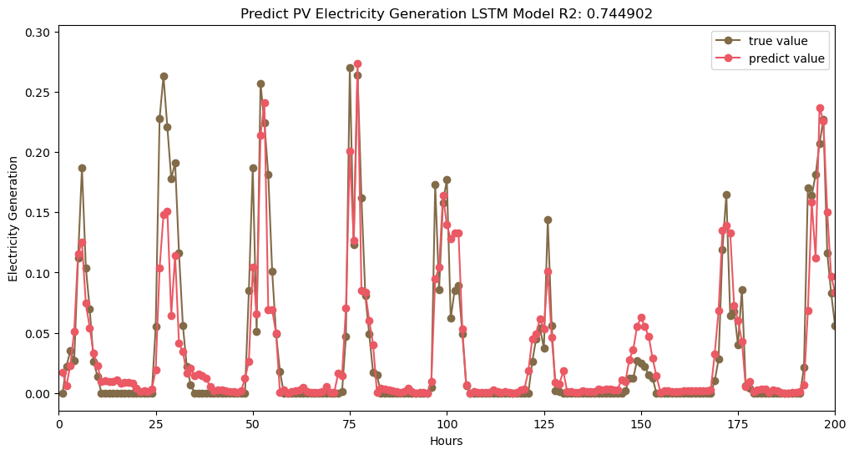
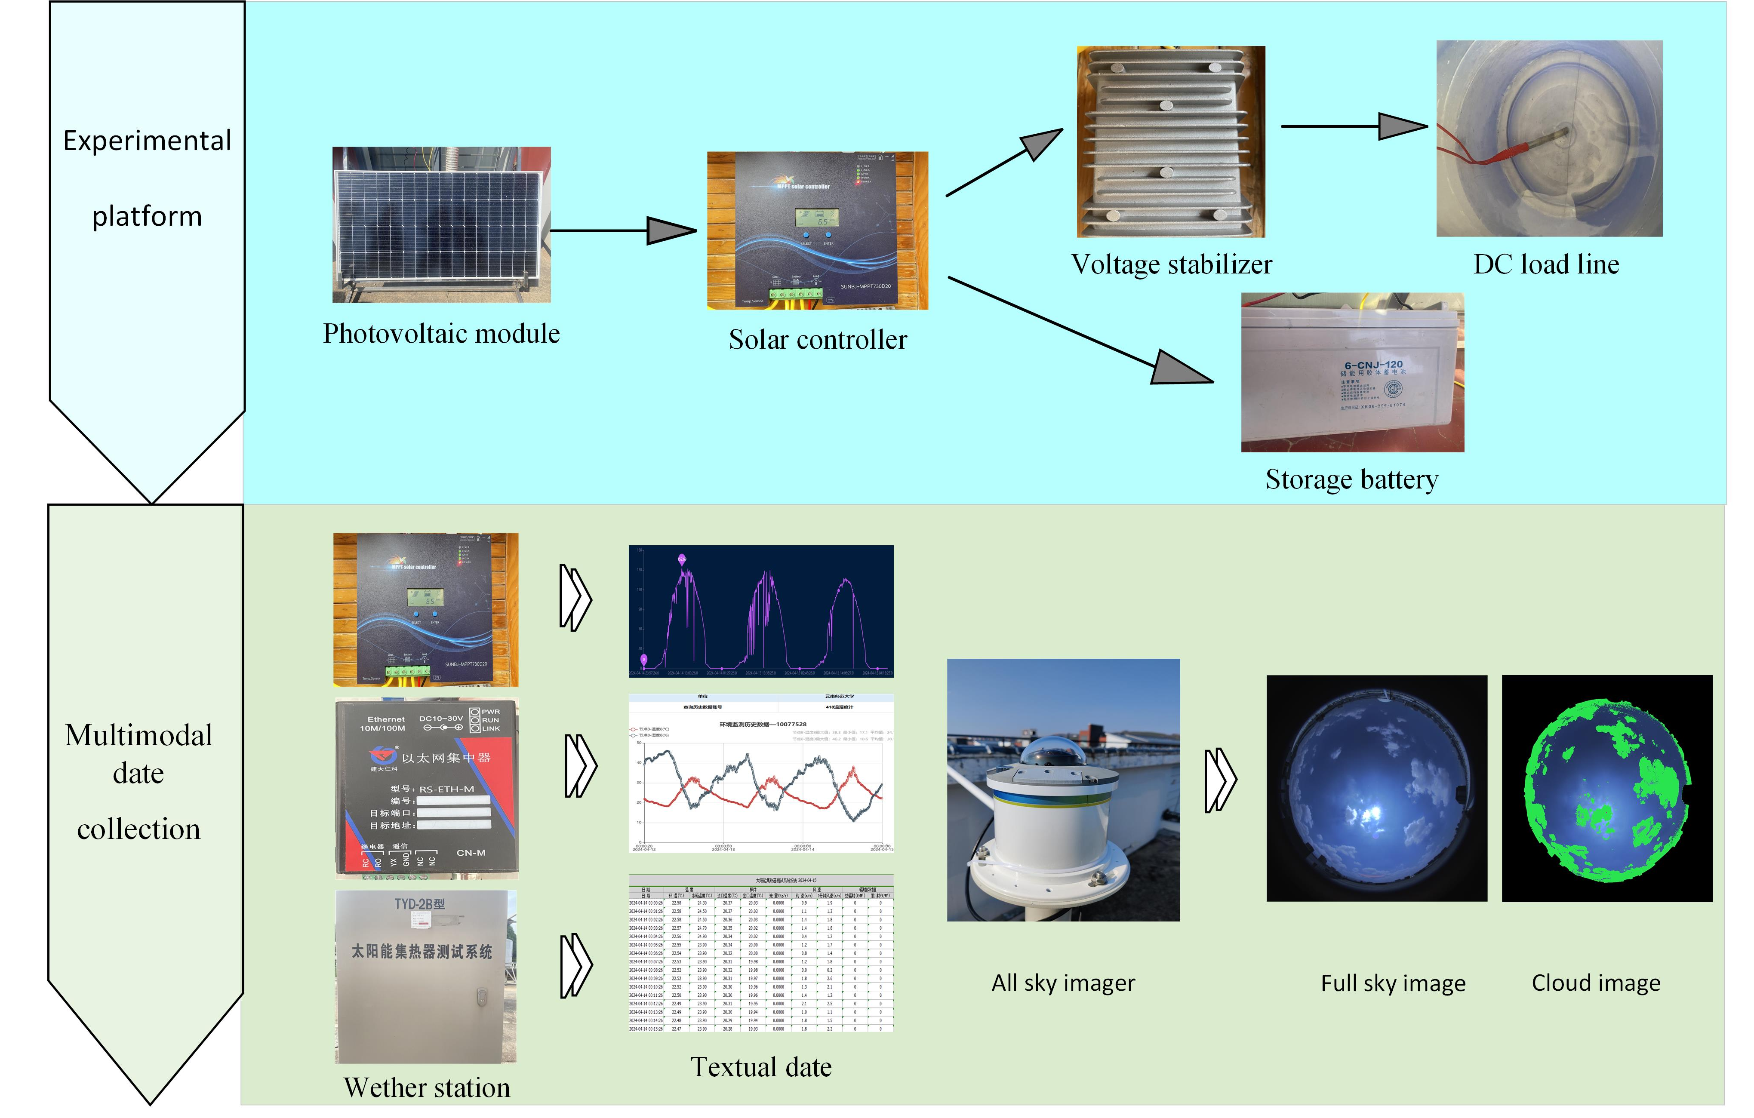
Short-term photovoltaic power forecasting based on deep temporal-spatial multi-modal model
Yiyuan He¹, Qiong Li1*, Zhaopeng Huang¹, Xiaoqiao Huang²
¹Ministry of Education Key Laboratory of Advanced Technique & Preparation for Renewable Energy Materials, Yunnan Normal University, China, liqiong@ynnu.edu.cn
²Yunnan Key Laboratory of Optoelectronic Information Technology, Yunnan Normal University, Kunming, 650500, China.
Introduction
The initial data (photovoltaic power time series) is first broken down into a series of intrinsic modal functions (IMFs) through Empirical Mode Decomposition (EMD) for easier input as a subsequent feature.
Subsequently, an improved Convolutional Neural Network (CNN) is used for image extraction followed by Long Short-Term Memory (LSTM) for text feature extraction. Finally, in the full connection layer, the extracted features are fused to generate the final output of the predicted power. This process enhances the accuracy and efficiency of predicting the power output. The average envelope m1 is determined from the time-series data x(t) local minima U(t) and V(t), as shown in formula (1). Using this average envelope, c₁ is obtained as the intrinsic modal number (IMF) by subtracting it from x(t), as indicated in formula (2). The residuals, depicting the gap between the time-series data and the mean envelope, are detailed in formula (3).Subsequently, a series of IMF components and a residual m1 are derived through the residual r₁(t), which repeats the above process, as depicted in formula (4). The use of EMD technique enables the decomposition of signals directly on the data's own timescale, eliminating the need to pre-define a base function beforehand.
Fig.2 compares the predicted photovoltaic power to the true power values over a 200-hour period in the test set. The analysis yields an R2 of 0.74 and an RMSE of 0.04. Although the overall prediction accuracy is improved, there is a notable decline in accuracy when the system generates excess power. This discrepancy may stem from the model's lack of complexity, making it challenging to capture nuanced relationships in instances involving a multitude of factors and variables.
The forecast of photovoltaic power has the potential to improve the energy efficiency of building systems, making photovoltaic integrated buildings a mainstream trend in the construction industry. Currently, the sources of photovoltaic power prediction data primarily rely on historical photovoltaic power and weather text data. However, the uncertainty in photovoltaic power fluctuations is influenced by the distribution of clouds, changes in their positions over time, and variations in how clouds of different optical thicknesses attenuate solar radiation^{[1]}. A five-layer CNN-LSTM model has been developed for photovoltaic power prediction^{[2]}, demonstrating superior performance compared to benchmark methods. Nevertheless, this model fails to account for the effects of cloud movement on photovoltaic power output.
To effectively quantify the influence of cloud on photovoltaic power, a hybrid model based on EMD-CNN-LSTM is proposed for predicting photovoltaic power generation. This model incorporates enhanced feature input and processes multi-modal data for multi-scale feature extraction, enhancing the generalization ability of the model.
Fig.2 The PV power value obtained from experiments and predicted
Conclusions
This paper aims to achieve accurate prediction of short-term photovoltaic power generation by employing the EMD-CNN-LSTM neural network model. The successful prediction serves to offer insightful recommendations for enhancing energy efficiency in energy-saving buildings. Despite the notable progress made, it is evident that further enhancement of prediction accuracy is warranted. This can be accomplished through optimization of the model, either by increasing the volume of data employed or by fine-tuning the model parameters to ensure improved performance.
Methodology
（1）
（2）
To gather experimental data, two research platforms were established: a photovoltaic water heater experimental platform and an all-sky imager experimental platform. The two platforms are used to capture sky image data, photovoltaic power generation data, and key weather data, respectively. The data acquisition equipment and approach are shown in Fig.1.
（3）
（4）
Results
The correlation between meteorological factors and photovoltaic power was determined using the Pearson correlation coefficient. Table 1 illustrates that the wind speed remains consistently low throughout the year in the area.
References
[1] Journals JORDEHI A R. How to deal with uncertainties in electric power systems? A review[J]. Renewable & sustainable energy reviews. 2018, 96: 145-155.
[2] Journals Tovar, M.; Robles, M.; Rashid, F. PV Power Prediction, Using CNN-LSTM Hybrid Neural Network Model. Case of Study: Temixco - Morelos, México. Energies, 2020, 13: 6512.
Table1. Pearson correlation coefficient table
 | T | RH | WS | GHR | DHR
P | 0.40 | -0.31 | 0.09 | 0.91 | 0.70
Fig.1 Experimental setup and data acquisition

