Slide 1



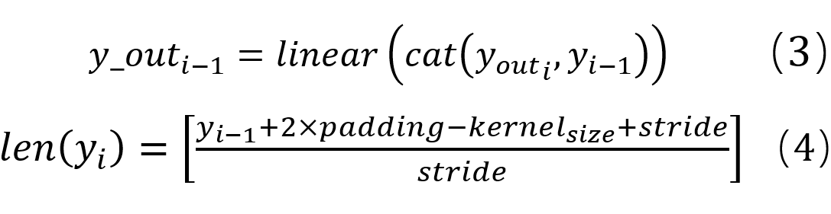
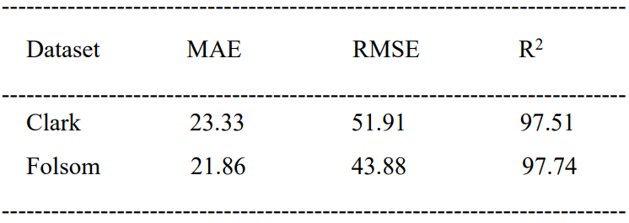
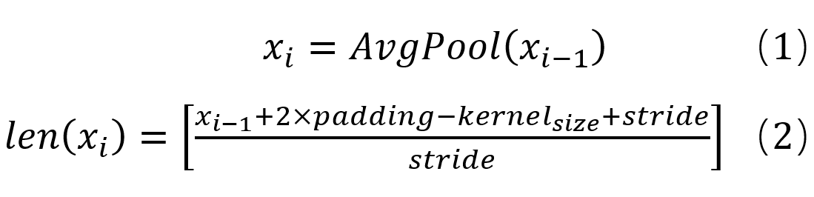
A hourly solar irradiance prediction method based on the UnetTSF model
Leyang Zhu¹, Xiaoqiao Huang^{1,2}*, Yonghang Tai^{1,2}
1 School of Physics and Electronic Information, Yunnan Normal University, Kunming, Yunnan 650500, China
2Yunnan key lab of optic-electronic information technology, Kunming, Yunnan 650500, China, hxq @ynnu.edu.cn
c
Introduction
trend and seasonal terms into their respective feature extraction modules for feature extraction and prediction, and then performing predictive feature fusion will cause the seasonal terms to lose their trend features and the trend terms to lose their seasonal features.
To better retain the trend and seasonal characteristics, this research provides a solar irradiance prediction approach based on the UnetTSF model. While the decoder module retains the effective features and uses progressive fusion operations to de-noise them, the U-shaped network (U-Net) encoder module compresses the input data and extracts useful features from it[1]. By bypassing the relevant levels of the encoder and decoder, the approach can retain the finer features lost during the encoder process. As a result, forecasts of solar irradiance become more accurate as the model is better able to incorporate seasonal patterns and trends in solar irradiance.
FPN is an effective tool for extracting features at different scales. The top of the pyramid typically contains more semantic information and concentrated trend features compared to the bottom, while the bottom of the pyramid has higher resolution and shallower information, making seasonal features more noticeable in the bottom layer. The multiscale temporal feature x is predicted by multiple fully connected predictions to get the predicted value Y={y₁,y₂,y₃,y₄}. The multi-stage fusion module splices y_{i-1} with y_{i} and then passes through the fully connected layer to get the output y_out_{i} to fully utilize the trend and seasonal features.
Since conventional fossil fuels are non-renewable, their significant depletion would not only result in an energy crisis but also grave environmental contamination. Because solar power generation is non-polluting, renewable, and distributed, governments all over the world have promoted and supported it.Solar power generation systems are influenced by meteorological factors, such as cloud cover, aerosols, and geographic location, among other complex factors. As a result, photovoltaic power generation is characterized by obvious stochasticity, volatility, and intermittency, in contrast to fossil energy power generation, which is continuous and artificially regulated. Large-scale photovoltaic power generation introduces significant problems to modern smart grid scheduling and operation planning due to its intermittent and unpredictable nature, which also increases the complexity of grid management. Thus, after PV is linked to the grid, achieving steady PV production is essential to guaranteeing grid stability and security, and producing constant PV output requires precise solar irradiance prediction.
Traditional statistical methods and physical models still have limitations in dealing with complex variations in solar irradiance, while neural network prediction methods in deep learning have become a hot research topic in this field. Recurrent neural network (RNN) can capture the temporal dependencies between sequences, but traditional RNN is prone to problems such as gradient vanishing when dealing with long sequences, and it is difficult to capture the long-term dependencies of time sequences; long-short-term memory network (LSTM) introduces the gating mechanism (input, forgetting, and output gates) and the memory unit based on RNN, and thus can deal with the long-term dependencies, but the result of the next time step of the LSTM model depends on the output of the previous time step, so LSTM is less efficient in large-scale datasets and long sequence tasks.
A time series' initial one-dimensional structure is typically employed to depict changes in nearby points in time, and it typically has a seasonal or cyclical nature. Every cycle has time points that are dependent on timings in other cycles. To capture these cyclical dependencies, many prediction methods have been successively proposed. Preprocessing the time series can effectively improve the forecasting ability of the model. The linear complexity model (DLinear) decomposes the series data into seasonal and trend terms and uses two single-layer linear networks to extract and forecast the two respectively and then sums them up to obtain the prediction results. Autoformer and FEDformer fuse trend and seasonal terms through a feature fusion model and use the fused features for forecasting. Binary decomposition is a commonly used data decomposition method in deep learning, but the seasonal and trend terms of the decomposed data items are correlated.
Simply decomposing the time series data into
Results
Methodology
The datasets used in this investigation are Clark and Folsom from the United States. They are from the National Renewable Energy Laboratory (https://midcdmz.nrel.gov). The first dataset, Clark, includes four years of comprehensive data from January 1, 2009 to December 31, 2012. The second dataset, Folsom, includes comprehensive data for three years, from January 1, 2014 to December 31, 2016.In this paper, the mean absolute error (MAE), root mean square error (RMSE), and R-squared (R2) is used to evaluate the models of interest together.
Table 1. Evaluation metrics compared proposed models with other models for one-hour ahead prediction.
    In this study, the proposed UnetTSF decomposes the time series into time series with seasonal, cyclic, trend, and fluctuation terms through the FPN module, extracts multi-scale temporal features through a multilayer extraction method, then predicts the future data by using multiple fully connected layers with output data of the same length as the input data, and finally fuses the upper features with local features through fusion module, and obtains the final prediction results[2].The model overview diagram of UnetTSF is shown below.
The experimental results show that UnetTSF can extract the features of time series data more accurately and automatically. The method has good prediction accuracy for different weather types, and the nRMSE is improved compared with other models.
Fig.1. Overview of the UnetTSF model
Time series prediction, which predicts future data by using historical data of length L X={x₁,x₂,…,x_{L}} as input. For a length D, X={x_{L+1},x_{L+2},…,x_{L+D}}, where xi is the number of channels in the input dataset at time I.
The Feature Pyramid Network (FPN) and the Unet network make up the UnetTSF model that is employed in this work. We use a multilevel extraction method because simple data decomposition may result in feature loss. We set the Unet network's number of layers to four by stage, the average pooling layer's step size to stride=1, the padding size to padding=1, and the pooling kernel size to kernel_size=3. The FPN module processes the original data X to obtain four layers of input data.
Conclusions
  To increase the precision of short-term solar irradiance prediction, we fully utilize the benefits of the U-Net model in this study's time series data prediction.UnetTSF extracts shallow and deep features more efficiently while lowering computational complexity. Based on the UnetTSF network, the findings offer a novel and efficient feature extraction technique for solar irradiance forecasting research.
References
[1]N. Navab, J. Hornegger, W.M. Wells, A.F. Frangi, Medical Image Computing and Computer-Assisted Intervention - MICCAI 2015: 18th International Conference Munich, Germany, October 5-9, 2015 proceedings, part III, Lect. Notes Comput. Sci. (Including Subser. Lect. Notes Artif. Intell. Lect. Notes Bioinformatics) 9351 (2015) 12–20. https://doi.org/10.1007/978-3-319-24574-4.
[2]T.Y. Lin, P. Dollár, R. Girshick, K. He, B. Hariharan, S. Belongie, Feature pyramid networks for object detection, Proc. - 30th IEEE Conf. Comput. Vis. Pattern Recognition, CVPR 2017 2017-Janua (2017) 936–944. https://doi.org/10.1109/CVPR.2017.106.

