Slide 1
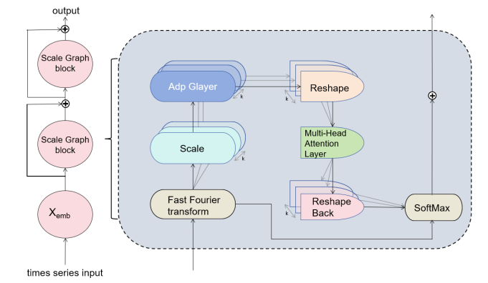
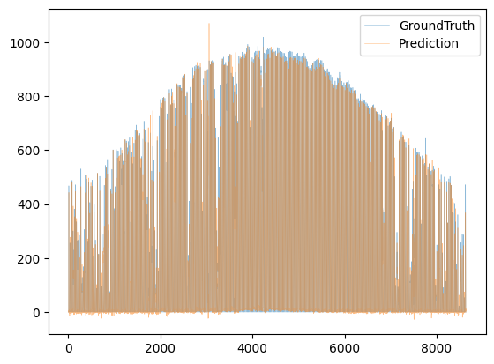
A multivariate hybrid model based on CPO-ICEEMDAN-MSGNet for solar irradiance prediction
Bingqian Wu¹, Xiaoqiao Huang^{1,2*,} Yonghang Tai^{1,2}
¹ School of Physics and Electronic Information, Yunnan Normal University, Kunming, Yunnan 650500, China
²Yunnan key lab of optic-electronic information technology, Kunming, Yunnan 650500, China, hxq @ynnu.edu.cn
Introduction
dependencies between sequences, a novel multi-scale adaptive graph convolution (MAGC) was utilized. Specifically, assuming there are S scales and T time series variables, the graph convolution is defined as follows:
In this research paper, RMSE(Root Mean Square Error),nRMSE (Normalized Root Mean Square Error), and MAE(Mean Absolute Error)are used as metrics to assess the prediction performance.
Table 1
Error metrics comparing the hour-ahead forecasts of the proposed model with other models.
Photovoltaic (PV) power generation, as a clean, secure and continuously growing form of energy, is gradually becoming a key component of the global energy transition. According to the International Energy Agency (IEA), the global PV power generation capacity is expected to nearly double to nearly 1 terawatt (TW) by 2024, and the installed PV capacity is expected to reach 650 GW by 2030, so improving the prediction accuracy of PV power generation is of great significance and application value. and application value. However, existing time series forecasting models often neglect the correlation between multiple time series at different time scales, which has certain limitations. In an attempt to make up for the shortcomings of the previous models, this study adopts the Improved Complete Ensemble Empirical Mode Decomposition with Adaptive Noise (ICEEMDAN) optimized and improved by the Crested Porcupine Optimizer (CPO) algorithm to decompose the data, and combines it with the MSGNet model to propose a new method for predicting the solar irradiance. The new method can significantly improve the prediction accuracy and provides a new thought for the solar irradiance prediction research.
Where $ℋ_{\text{out} }^{i}$irepresents the output after fusion with scale $i$, $σ\left(\right)$denotes the activation function, hyperparameter $P$ is a set of integer connection
powers indicating column-wise connections, $∥$ denotes column-level connectivity, ${\left(A^{i}\right)}^{j}$is the adaptive adjacency matrix, and $ℋ^{i}∈ℝ^{N×s_{i}×f_{i}}$is obtained by projecting the tensor corresponding to the i-th scale, regressing it to a tensor space with $N$ variables, thereby capturing specific and comprehensive dependencies between sequences.
Method | nRMSE | RMSE | MAE
Autoformer | 24.12 | 50.07 | 30.77
DLinear | 23.17 | 48.10 | 27.28
Informer | 36.72 | 76.23 | 46.96
Ours | 20.58 | 42.72 | 21.03
The experimental results demonstrate that the time series data decomposed by CPO-ICEEMDAN and then processed by the MSGNet model outperforms the existing model in terms of prediction accuracy, which can captured the correlation between multi-scale sequences in a better way, and has higher performance performance and the strongest anti-interference ability.
Conclusions
Methodology
Fig. 1. There are several ScaleGraph modules in MSGNet, and the modules include: the FFT module, the adaptive graph convolution module, and the multi-head attention module.
In this research, we optimized ICEEMDAN using the CPO algorithm to process the data, and then input the processed data into a deep learning model, MSGNet, which utilizes periodicity as a scale source to capture time series correlation and correlation features on different time scales, thus fully capturing the complex interdependencies between time series on different time scales. The results indicate that the prediction accuracy of time-series data after CPO-ICEEMDAN decomposition is superior to that of existing models when MSGNet is used again for prediction. This result provides a new effective research idea and method for solar irradiance prediction based on signal processing combined with MSGNet model.
DATA DECOMPOSITION
Finally, a multi-head attention mechanism is employed to capture intra-sequence correlations, efficiently integrating multi-scale features into the next layer, efficient extraction of multiple inter- and intra-sequence features.
To enhance the decomposition effectiveness of ICEEMDAN on time series data, this study utilized the CPO algorithm^{[1]} to optimize two parameters of ICEEMDAN: the amplitude weight of white noise (Nstd) and the number of noise additions (ME). The decomposition steps are as follows: firstly, initialize the population of CPO algorithm, set the number of iterations and the population size of CPO, and set the parameter optimization range of ICEEMDAN algorithm; subsequently, use ICEEMDAN to decompose the signal and calculate the envelope entropy of each IMF component, and take the minimum of the envelope entropy as the fitness function; determine whether the optimization has reached the requirements of CPO, and if it has reached the requirements, then Save the optimal ICEEMDAN parameter combinations and substitute them into ICEEMDAN to construct the CPO algorithm for ICEEMDAN; finally, use the CPO-ICEEMDAN method to decompose the signals and obtain the optimal IMF components.
Results
In this research, the nature-inspired meta-heuristic optimization algorithm CPO combined with improved complete ensemble empirical mode decomposition with adaptive noise is used to process the data, and the prediction is made after extracting the features of the data via the MSGNet model, the dataset of which is obtained from the U.S. National Solar Irradiance Database and Instrumentation Data Center, provided at the National Renewable Energy Laboratory (https://midcdmz.nrel. gov)
References
[1]M.Abdel-Basset, R. Mohamed, M.Abouhawwash. Crested Porcupine Optimizer: A new nature-inspired metaheuristic. Knowledge-Based Systems, 284, 111257(2024).
[2]W. Cai, Y. Liang, X. Liu, J. Feng, Y. Wu. MSGNet: Learning Multi-Scale Inter-Series Correlations for Multivariate Time Series Forecasting. InProceedings of the AAAI Conference on Artificial Intelligence 38, 11141-11149(2024 ).
MSGNet
Subsequently, the decomposition results of CPO-ICEEMDAN were input into the MSGNet network model ^{[2]}, whose framework is illustrated in Figure 1. After normalizing N variables, they were projected into a one-dimensional matrix using one-dimensional convolution. The core operations of MSGNet were implemented using residual connections. Fast Fourier Transform (FFT) was performed to select the periodicity of the time series data as the scale source. For capturing local and global
Fig. 2. These are the predictions using the dataset Folsom, comparing the predicted values with the true values.

