Slide 1
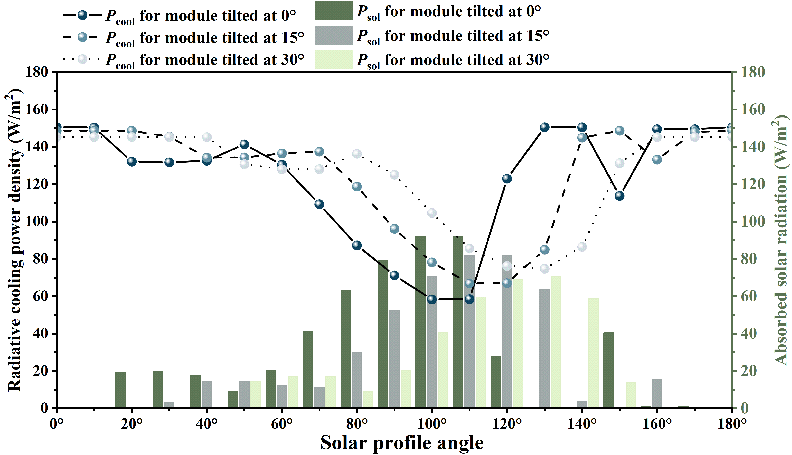
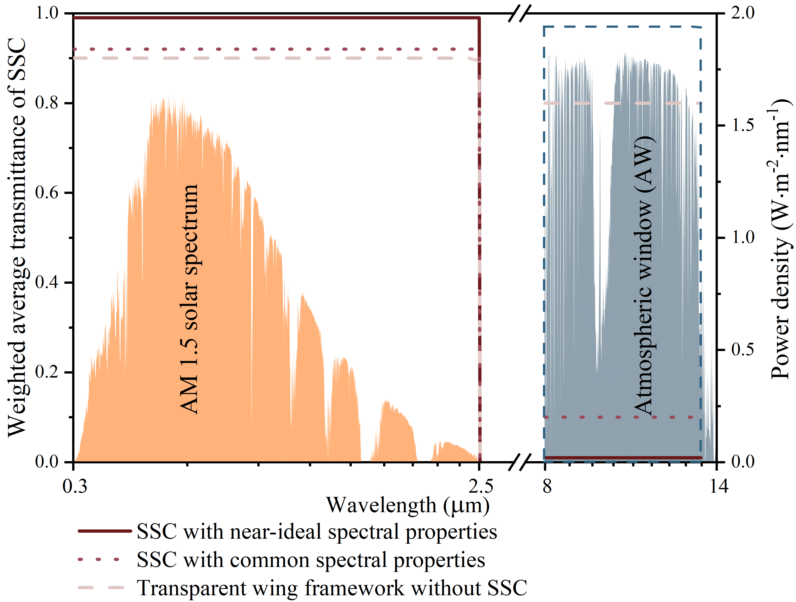
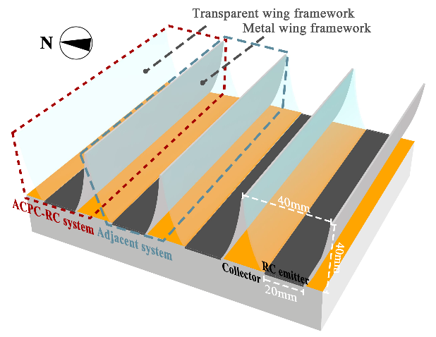
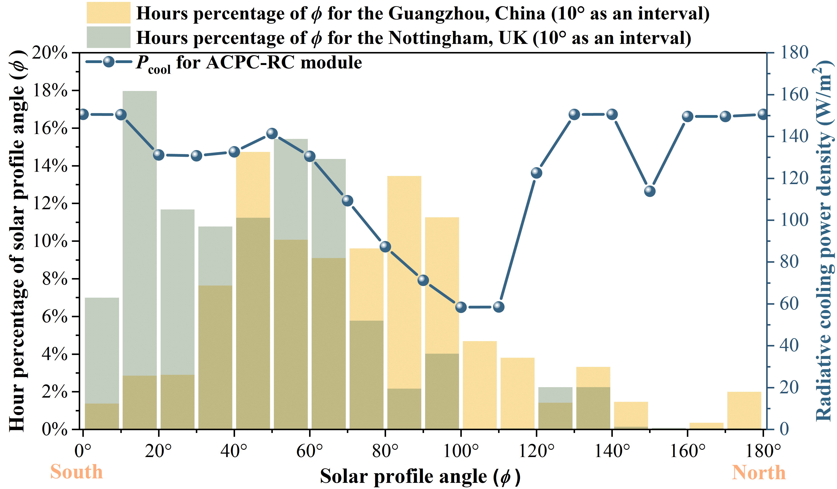
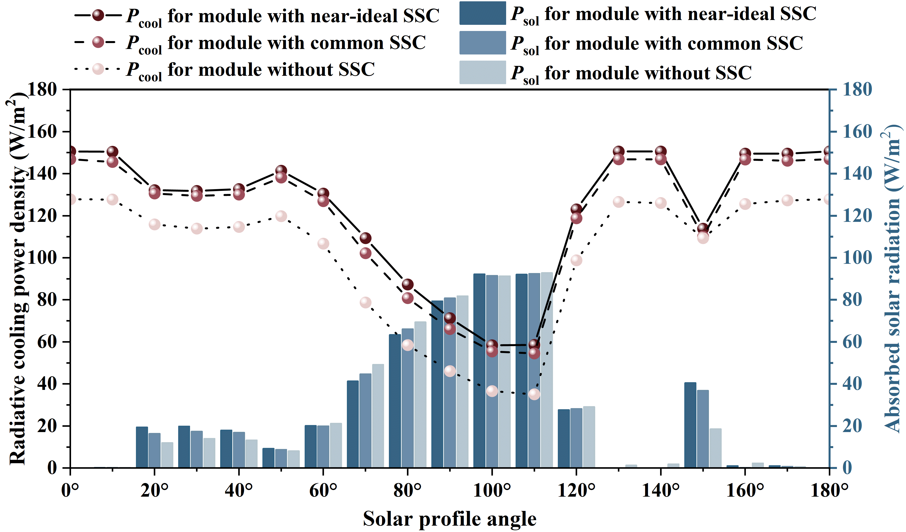
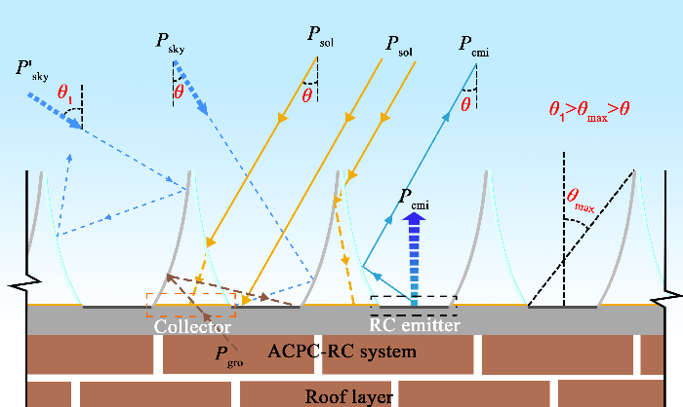
A novel radiative cooling system integrated with an asymmetric material-based compound parabolic concentrator
Ya Dan1, Qiliang Wang1*, Mingke Hu2, Dongliang Zhao3, Saffa Riffat1, Yuehong Su1*
1 Department of Architecture and Built Environment, University of Nottingham, Nottingham NG7 2RD, UK
2 School of Electrical Engineering, Southwest Jiaotong University, Chengdu, 610031, China
3 School of Energy and Environment, Southeast University, Nanjing, Jiangsu, 210096, China
Introduction
Results and discussion
This section discusses the impact on the RC effect when the transparent wing framework of the ACPC-RC module is covered by SSCs with different spectral properties. Fig. 3 presents the weighted average transmittance (τ) under the solar spectrum and atmospheric window for two types of SSCs and the transparent wing framework without SSC.
EFFECT OF DIFFERENT SPECTRAL PROPERTIES OF SSC ON ACPC-RC MODULE
Radiative sky cooling (RC) technology is known for its capability to passively emit the Earth's waste heat into the cold outer space through a transparent 'atmospheric window' with a wavelength of 8-13 μm. Its potential for self-cooling without the need for additional energy input makes it enormously promising in the field of building cooling. However, the inherently low power density of RC technology, typically characterized by a cooling flux of approximately 100 W/m² at ambient temperature, is easily offset by the high power density of daytime solar radiation, approximately 1000 W/m². This imbalance renders RC technology unable to meet the all-day cooling requirements of buildings. Therefore, it is crucial to enhance the cooling power density and reduce the solar radiation's harassment on the RC system.
In addition to research on near-ideal spectrally selective materials to reduce the absorption of solar radiation by RC modules and thereby enhance cooling performance, the integration of RC modules with concentrators (called concentrated RC systems) also shows potential to address challenges simultaneously. Inspired by this novel structure, a novel RC system based on CPC of asymmetric materials (termed ACPC-RC module) is further proposed,as shown in Fig. 1. In this study, a modelling approach is employed to accurately evaluate the absorbed solar radiation (P_{sol}) and net RC power density (P_{cool}) of ACPC-RC modules. Furthermore, the effects of various parameters, such as the spectral properties of different transparent wing frameworks of ACPC and module tilt angles on the module's cooling performance are examined.
Fig. 5. Absorbed solar radiation and radiative cooling power density for ACPC-RC modules tilted at different angles under different solar profile angles.
COOLING POWER FOR ACPC-RC MODULE UNDER DIFFERENT HOURS PERCENTAGE OF SOLAR PROFILE ANGLES
Fig. 3. Weighted average transmittance of ACPC glass wing framework with and without SSC.
Fig. 6 displays the hours percentage of ϕ in different cities and the corresponding P_{cool} for horizontally placed ACPC-RC module. It is noted that when 0<ϕ<10°, the highest P_{cool} of 150 W/m² can be obtained. However, throughout the year, hours percentage at this angle range is only 1.3% in Guangzhou, while in Nottingham it is 6.7%. Furthermore, in Nottingham, P_{cool} ranging from 131.18 to 150.45 W/m² is achieved 73% of the hours when ϕ is between 10-60°, while in Guangzhou, such P_{cool} is achieved only 38.2% of the hours. Conversely, when 60°<ϕ≤110°, more P_{sol} is absorbed. In Guangzhou, ϕ falls within this range 48.1% of the hours, and the average P_{cool} obtained during this period is only 76.96 W/m². Fortunately, when ϕ is greater than 120°, a significantly improved corresponding P_{cool} is obtained. However, the hours percentage within these angle ranges is minimal, accounting for 8.5% and 4.6% in Guangzhou and Nottingham, respectively. This indicates that ϕ in the range of 0-120° has the largest hours percentage in a year.
Fig. 4 indicates the P_{sol} absorbed by the three ACPC-RC modules and their obtained P_{cool} at different solar profile angle (ϕ). It is evident that when the ϕ is less than 20°, P_{sol} of 0 W/m² is absorbed by the three modules, resulting in the highest P_{cool}. At 0°, P_{cool} of 127.83 W/m² is obtained by the module without SSC, which is 15.1% and 13% lower than that obtained by the modules with near-ideal SSC and common SSC, respectively. However, as the ϕ increases, an increase in the P_{sol} absorbed by each module is observed, causing a gradual decrease in P_{cool}. Specifically, at ϕ of 100°, P_{sol} of 91.25 W/m² is absorbed by the module without SSC, while the P_{sol} absorbed by the modules with near-ideal SSC and common SSC is 92.21 and 91.46 W/m², respectively, showing little difference among the three modules. Nevertheless, P_{cool} of only 36.58W/m² is obtained by the module without SSC, which is 37.3% and 34.1% lower than that of the modules with near-ideal SSC and common SSC, respectively. As the ϕ exceeds 110°, a rapid decrease in the P_{sol} absorbed by the modules is noted, and their P_{cool} correspondingly increases. However, due to the influence of adjacent modules, fluctuations in the P_{cool} for the three modules are observed at 150°.
Fig..1. Schematic diagram of ACPC-RC multi-module system.
Description of the ACPC-RC module
Fig. 6. Hours percentage of the solar profile angles in different cities and their corresponding net radiative cooling power density for ACPC-RC module.
Fig. 2 illustrates the radiative heat exchange between the ACPC-RC system and its surroundings. It can be seen that, unlike the traditional CPC structure with opaque metal wing frameworks on both sides that concentrate solar radiation from small zenith angles onto the emitter, the transparent side of the ACPC structure allows solar radiation to pass through it to the collector, mitigating its impact on the RC emitter. Additionally, due to the transparent wing framework covered with SSC showing high reflectivity under the atmospheric window, ACPC can concentrate the thermal radiation emitted by the RC emitter to a smaller range of zenith angles. Finally, when the incident angle (θ₁) of unfavourable radiation from the sky and the sun exceeds the maximum half-acceptance angle (θ_{max}) of ACPC, it cannot reach the emitter, demonstrating ACPC's excellent shielding function.
Conclusions
At different solar profile angle (ϕ), the ACPC-RC module with near-ideal SSC is found to exhibit the highest net cooling power density (P_{cool}). At 0°, its P_{cool} is measured at 150.58 W/m², which is 2.7% and 15.5% higher than the P_{cool} for the modules with common SSC and without SSC, respectively. As ϕ increases to 100°, the P_{cool} for the three modules decreases to the lowest.
The study of hours percentage of ϕ in different cities throughout the year reveals that in low latitudes, such as Guangzhou, ϕ is in the range of 60°-110° for nearly half of the hours, and an average P_{cool} of 76.96 W/m² is obtained during this time. Moreover, when ϕ exceeds 120°, a significant improvement in the corresponding P_{cool} is observed, with 8.5% of the hours in Guangzhou falling within this range.
Fig. 4. Absorbed solar radiation and radiative cooling power density for ACPC-RC modules with and without SSC.
EFFECT OF DIFFERENT TILT ANGLES OF ACPC-RC MODULE
This section analyzes the variations in P_{sol} and P_{cool} for the ACPC-RC modules tilted northward at 0°, 15°, and 30° under different ϕ. As shown in Fig. 5, until the ϕ is less than 40°, the P_{sol} absorbed by the module tilted at 30° is observed to be consistently 0 W/m², resulting in the best cooling performance of 145.35 W/m². In contrast, when ϕ reaches 20° and 30°, modules tilted at 0° and 15° begin to be affected by solar radiation, with 19.40 and 3.29 W/m² of P_{sol} being absorbed. This means the two modules are significantly more affected by P_{sol} than the module tilted at 30°. For the module tilted at 0°, in the ϕ range from 50° to 110°, an increase in absorbed P_{sol} with an increasing ϕ is observed, resulting in a 58.6% decrease in P_{cool} from 141.41 to 58.55 W/m² at 110°. However, when the module tilted at 30°, the P_{cool} for ϕ at 110° is observed to be 46.3% higher than that of the module tilted at 0°.
This study would like to acknowledge the Engineering and Physical Sciences Research Council (Horizon Europe Guarantee grant number: EP/Y016645/1) and the Royal Society's International Exchange Scheme (grant number: IEC\NSFC\223283) for the financial support to this study.
Acknowledgments
Fig. 2. Radiative heat exchange between ACPC-RC system and surroundings.

