Slide 1
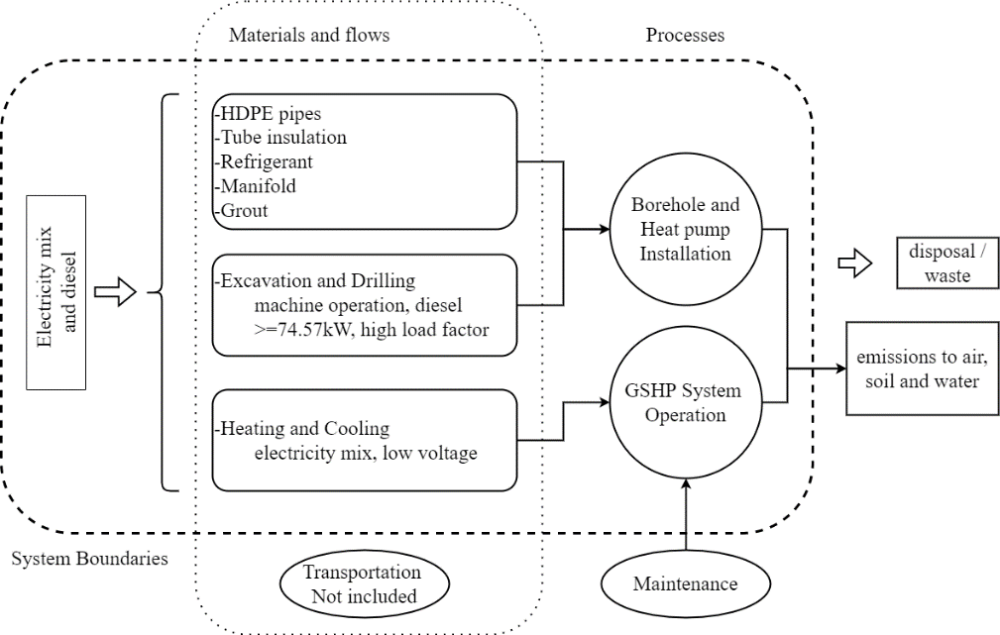
Environmental Impact of Ground Source Heat Pumps versus Air Source Heat Pumps in different climates
ALTERNATIVE ENERGY SOURCES, MATERIALS AND TECHNOLOGIES (AESMT’24)
14 - 15 May, 2024, Sofia, Bulgaria
Methodology
Ground Source Heat Pumps (GSHPs) form one of the most well-known types of geothermal energy systems, and are typically compared with the Air Source Heat Pumps (ASHP). The GSHPs, compared to ASHPs, exhibit significantly higher performance but with a greater initial cost (higher investment).
The heating and cooling loads for 7 cases (European cities in different countries), namely Lefkosia–Cyprus(CY), Seville–Spain(ES), Bologna–Italy(IT), Lisbon–Portugal(PT), Belgrade–Serbia(SRB), Berlin-Germany(DE), Stockholm–Sweden(SE), are considered here, shown in Figure 1. The residential heating and cooling loads data, as well as the ground thermal characteristics for each area, are used as input to GLD (Ground Loop Design, Thermal Dynamics Inc., MN, USA).
The system boundaries for the GSHP systems with different types of GHEs are presented in Figure 2. A cradle-to-grave approach impact has been adopted with the boundaries including the extraction and process of raw materials, transportation, installation and operation related only to the GHEs and not the HPs.
The operation stage is considered for the lifetime of the system. In this study the lifetime of the HP is set at 15 years (note that for the GHE, it can be higher). The operation of the system depends on the annual heating energy demand and the performance of the system (related to operation process, see Table 1). The electricity demand of each system, estimated using the COP of each system, is presented in Table 1, where the COP for each of the different GSHP systems was estimated using the GLD software, as presented in Figure 1.
Results and Discussion
The highest manufacturing impact was produced by the coaxial configuration in all cases (countries), with the highest of these being in SE. For all cases the ASHP system produces the highest impact, except for the case of SE, where all types of GSHP systems have a higher GWP impact than ASHP (see Figure 3).
ASHP system corresponding to 100% has different values (per FU) for each country, namely 3.12×10⁴, 1.09×10⁴, 2.05×10⁴, 7.63×10³, 2.49×10⁴, 4.38×10⁴, and 6.71×10³ kg CO2-eq for CY, ES, IT, PT, SRB, DE and SE respectively. The GWP impacts for all cases, except SE, are lower by 13–43%, while for SE higher by 11–18%.
The higher heating loads in the northern countries lead to higher differences in electricity demand between GSHP and ASHP systems, and hence the GWP impact produced was expected to be lower; this is though not the case for SE, where a higher impact is observed, owing to the high share of renewables in the electricity mix of that country.
Lazaros Aresti^{1,2} and Paul Christodoulides^{1,2}
¹ EMERGE CoE, Lemesos, Cyprus,
² Faculty of Engineering and Technology, Cyprus University of Technology, Lemesos, Cyprus
*Correspondence: lg.aresti@edu.cut.ac.cy
Rationale and Summary
Following the European Union (EU) targets towards the “Fit for 55”, the heat pump (HP) sales have seen an increase. The recent increasing demand in the utilization of HP towards space heating and cooling, underscores the pivotal role of Shallow Geothermal Energy (SGE) systems and the Ground Source Heat Pumps (GSHPs). Although GSHPs exhibit higher performance compared to Air Source Heat Pumps (ASHPs), the high initial cost and the consequent long payback period has been a preventive factor for the GSHP systems. The GSHP systems however also benefit for additional CO2 reduction. The evolving efficiency of ASHP systems in recent studies challenge the perceived advantages associated with GSHPs, particularly in light of the continual refinement of ASHP systems.
This research embarks upon a comprehensive analysis to compare the environmental impacts, in terms of CO2 emissions, between ASHP and GSHP systems using different case studies. High insulation profile case studies were considered, following the nearly Zero Energy Buildings (nZEB) technical characteristics. The current study engages a Life Cycle Analysis (LCA) with the OpenLCA software in conjunction with the Ecoinvent database, and the employment of the ReCipe impact method, from a midpoint perspective. The findings derived from this investigation demonstrate a favorable performance of the GSHP systems where there is an increasing demanding in heating such as in the retrofitting cases. Hence, this research highlights the important environmental implications of employing the GSHPs over the use of ASHPs.
Fig. 3. Percentage ratio of GSHP systems to ASHP per country per FU, for the GWP impact
The operation process ranges between 91–93% and 42-45% for CY and SE respectively. For the rest of the countries under investigation, the operation process share ranged between 74–91% for all cases.
In the northern countries, due to the use of environmentally friendlier ways and RES for electricity generation, the grid electricity mix has lower carbon emissions than the southern countries, but higher heating demand.
Fig. 2. LCA System boundaries for all GSHP systems under investigation
City, Country | GSHP annual and (lifetime) electricity demand [kWh] | ASHP annual and (lifetime) electricity demand [kWh] | Annual and lifetime difference between GSHP and ASHP [%]
Lefkosia, CY | 1334 (20006) | 2093 (31398) | 36
Seville, ES | 1498 (22475) | 2211 (33164) | 32
Lisbon, PT | 791 (11872) | 1224 (18335) | 39
Bologna, IT | 2156 (32335) | 3231 (48472) | 35
Belgrade, SRB | 2353 (35294) | 3970 (59557) | 41
Berlin, DE | 2629 (39437) | 5101 (76510) | 48
Stockholm, SE | 4204 (63053) | 8407 (126105) | 50
City, Country | Total borehole length, m |  |  | Refrigerant Calcium Chloride
 | Single U-tube | Double U-tube | Coaxial
Lefkosia, CY | 152.4 | 132.5 | 131.9 | (pure water)
Seville, ES | 267.3 | 227.3 | 200.5 | (pure water)
Lisbon, PT | 136.0 | 116.5 | 114.2 | 9.7%
Bologna, IT | 142.6 | 124.4 | 120.4 | 11.3%
Belgrade, SRB | 158.8 | 139.6 | 125.2 | 18.1%
Berlin, DE | 238.9 | 211.8 | 196.5 | 18.1%
Stockholm, SE | 411.7 | 367.3 | 320.4 | 18.1%
Selected References
N. Bartolini, A. Casasso, C. Bianco, R. Sethi, Environmental and Economic Impact of the Antifreeze Agents in Geothermal Heat Exchangers, Energies. 13 (2020) 5653. doi:10.3390/en13215653
L. Aresti, P. Christodoulides, G.A. Florides, An investigation on the environmental impact of various Ground Heat Exchangers configurations, Renew. Energy. 171 (2021) 592–605. doi:10.1016/j.renene.2021.02.120
L. Arestii, G. A. Florides, A. Skaliontas, P. Christodoulides, Environmental Impact of Ground Source Heat Pump Systems: A Comparative Investigation From South to North Europe. Frontiers in Built Environment, 8 (2022) 914227. doi:10.3389/fbuil.2022.914227
P. Christodoulides, L. Aresti, G. Florides, Air-conditioning of a typical house in moderate climates with Ground Source Heat Pumps and cost comparison with Air Source Heat Pumps, Appl. Therm. Eng. 158 (2019) 113772. doi:10.1016/j.applthermaleng.2019.113772
C.J. Koroneos, E.A. Nanaki, Environmental impact assessment of a ground source heat pump system in Greece, Geothermics. 65 (2017) 1–9. doi:10.1016/j.geothermics.2016.08.005.
B. Greening, A. Azapagic, Domestic heat pumps: Life cycle environmental impacts and potential implications for the UK, Energy. 39 (2012) 205–217. doi:10.1016/j.energy.2012.01.028
P. Blum, G. Campillo, W. Münch, T. Kölbel, CO2 savings of ground source heat pump systems – A regional analysis, Renew. Energy. 35 (2010) 122–127. doi:10.1016/j.renene.2009.03.034
Fig. 1. Yearly heating and cooling loads per country for the same dwelling under investigation
More Detailed Information at:
Aresti, L., Florides, G. A., Skaliontas, A. & Christodoulides, P. (2022). Environmental Impact of Ground Source Heat Pump Systems: A Comparative Investigation From South to North Europe. Frontiers in Built Environment, 8, 914227.
https://doi.org/10.3389/fbuil.2022.914227
Table 1. Annual and lifetime electricity demand of GSHP and ASHP systems
Table 2. Total Borehole length with different GHE configurations and different rate of antifreeze solution at each city, estimated using the GLD software

