Slide 1
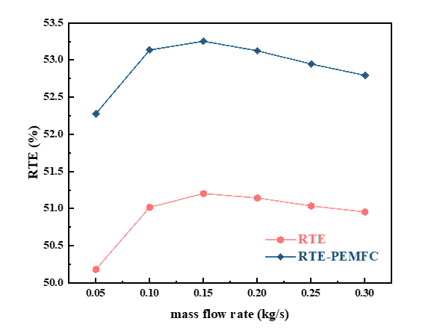
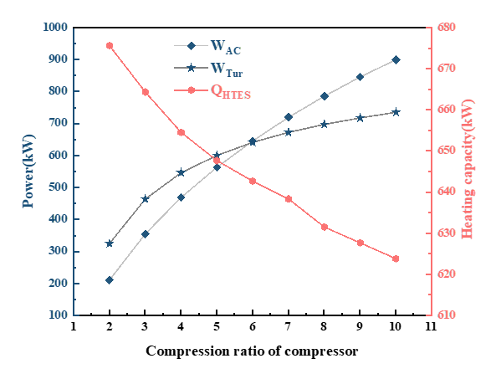
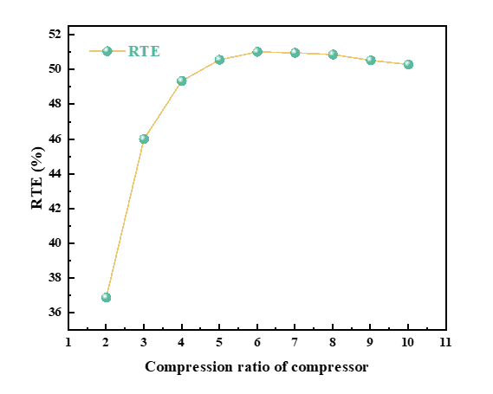
Integrated Hydrogen Energy Storage with Thermoelectric Generation: Performance and Efficiency Analysis
R. Zhang
College of Energy and Mechanical Engineering,SUEP, Shanghai – China
J. Cai
College of Energy and Mechanical Engineering,SUEP, Shanghai – China
Shanghai Non-carbon Energy Conversion and Utilization Institute, Shanghai, China
Z. Shi
College of Energy and Mechanical Engineering,SUEP, Shanghai – China
Shanghai Non-carbon Energy Conversion and Utilization Institute, Shanghai, China
Guangzhou Institute of Energy Conversion, Guangzhou, China
Introduction
The thermoelectric generator used in this system is a ring-shaped heat exchanger. its thermal balance equation is as follows[4] :
(2)
(3)
The final derived formula for the power generation of the turbine is[5] :
(4)
The basic expression for the voltage of a single cell is:
(5)
EFFECT OF HYDROGEN MASS FLOW RATE
Figure 4 shows the variation in the system's round-trip efficiency as the mass flow rate of hydrogen changes. It is evident from the figure that as the hydrogen mass flow rate gradually increases, the round-trip efficiency of the system initially increases and then decreases. The system's round-trip efficiency increases from 52.27% to 53.25% and then decreases to 52.79%. This demonstrates that before the hydrogen mass flow rate reaches 0.15 kg/s, the increase in the total power generation of the hydrogen storage system is greater than the increase in the total power consumption. However, after the hydrogen mass flow rate reaches 0.15 kg/s, the increase in the total power generation of the hydrogen storage system is less than the increase in the total power consumption. At a hydrogen mass flow rate of 0.15 kg/s, the system's round-trip efficiency reaches its maximum value of 53.25%. Additionally, we also calculated the round-trip efficiency of the hydrogen storage system without the PEMFC under the same operating conditions. Similarly, at a mass flow rate of 0.15 kg/s, the system's round-trip efficiency reaches its maximum value of 51.2%. The round-trip efficiency of the hydrogen storage system with the PEMFC is 2% higher than that of the hydrogen storage system without the PEMFC under the same conditions.
Gaseous compression hydrogen storage is currently the most common and direct method of hydrogen energy storage in industry[1] . However, compressing hydrogen to high pressure requires a large amount of energy, resulting in energy loss during the hydrogen storage process[2] . Compressed air energy storage (CAES) systems involve the storage and conversion of multiple forms of energy, including cold, heat, and electricity[3] . Such systems exhibit excellent environmental adaptability and compatibility, making them easy to integrate and couple with various energy systems. Thermoelectric generation technology can effectively collect and utilize low-grade energy generated at industrial production sites, converting it into electricity. Combining hydrogen storage with compressed air energy storage and thermoelectric power generation offers significant advantages.
Results
System description
EFFECT OF COMPRESSION RATIO
The impact of compressor compression ratio on compressor power consumption, turbine power generation, and the heat supply required by HTES is shown in Fig. 2. When the compressor compression ratio increases, the compressor power consumption and turbine power generation increase, and the heat required by HTES gradually decreases.the temperature of the hydrogen discharged from the compressor increases, resulting in higher temperature of the hot water in the hot water tank. In these cases, the use of hot water by the low-temperature thermal energy storage unit can increase the temperature of the hydrogen before entering the HTES unit during the discharge stage of the system, thereby reducing the heat supply required by the HTES unit.
    Thermoelectric generation integtated compressed hydrogen energy storage system (TEG-CHES) structure is illustrated in Figure 1. The TEG-CHES system mainly consists of three parts: the hydrogen compression system, the turbine power generation system, and the proton exchange membrane fuel cell (PEMFC) system.
    During the energy storage stage, low-cost electricity generated by solar or wind energy is consumed by the compressor and the high-temperature thermal energy storage unit (HTES). During off-peak periods, the generated electricity is used to drive the compressor for hydrogen compression and storage in the hydrogen storage tank. The surplus electricity is directly converted into heat through resistive heating inside the HTES. Waste heat during the compression process is recovered using TEG during the intermediate cooling process.
    During the discharge stage, the compressed hydrogen stored in the hydrogen storage tank is released to drive the air turbine. A pressure regulating valve is used to provide constant pressure exhaust for the hydrogen storage tank before heating. The hydrogen is preheated sequentially in the low-temperature and high-temperature thermal energy storage units (LTES and HTES), and then enters the turbine to drive its power generation. After power generation by the turbine, the hydrogen is directly fed into the proton exchange membrane fuel cell (PEMFC) for further application.
    Fig. 4. The variation in the system's round-trip efficiency as the mass flow rate of hydrogen changes.
Conclusions
    Fig. 2. Influence of Compressor Pressure Ratio on Compressor Power Consumption, Turbine Power Generation, and Heat Supply Required by HTES.
  The main conclusions drawn from all these work are:
  - As the compression ratio of the compressor increased from 2 to 10. The round-trip efficiency initially increased and then gradually decreased, the round-trip efficiency reached its maximum value of 51.02 % when the compression ratio was 6;
  - The mass flow rate of hydrogen increased from 0.05 kg/s to 0.3 kg/s,The round-trip efficiency of the system initially rose from 52.27% to 53.25%, then decreased to 52.79%. The maximum round-trip efficiency of the system was achieved at a hydrogen mass flow rate of 0.15 kg/s, reaching 53.25%;
  - Changing the working fluid of the system, an evaluation of the overall performance is conducted, resulting in the system being able to generate 1344.5 kW of electricity with a round-trip efficiency of 54.4%.
  From Figure 3, it can be observed that as the compression ratio increases, the round-trip efficiency first increases and then gradually decreases. The maximum round-trip efficiency, with a value of 51.02%, is achieved at a compression ratio of 6. Prior to a compression ratio of 6, the electricity generation of the turbine exceeds the power consumption of the compressor, and the required heating for the HTES decreases, leading to an increase in round-trip efficiency. After 6, the situation is reversed.
References
    Fig. 1. Schematic diagram of the system simulation model based on Aspen Plus.
[1] J. Zheng, X. Liu, P. Xu, et al. Development of high pressure gaseous hydrogen storage technologies. International journal of hydrogen energy 37, 1048-1057 (2012).
[2] R. Zhang, J. Cai, T. Zhang, et al. Performance analysis and optimization of a TEG-based compression hydrogen storage waste heat recovery system. Renewable Energy 219, 119521 (2023).
[3] GF. Frate, L. Ferrari, U. Desideri. Energy storage for grid-scale applications: technology review and economic feasibility analysis. Renew Energy 163,1754–72 (2021).
[4] B. Singh, W. Mohamed, M. Hamani, et al. Enhancement of low grade waste heat recovery from a fuel cell using a thermoelectric generator module with swirl flows. Energy 236, 121521 (2021).
[5] M. Javidmehr, F. Joda, A.Mohammadi. Thermodynamic and economic analyses and optimization of a multi-generation system composed by a compressed air storage, solar dish collector, micro gas turbine, organic Rankine cycle, and desalination system. Energy conversion and management 168, 467-481 (2018).
Mathematical modeling
The compressor uses a stage compression, intermediate cooling compressor. It is represented by Eq. (1).
(1)
    Fig. 3. Impact of Pressure Ratio Changes on Round-Trip Efficiency.

