Slide 1
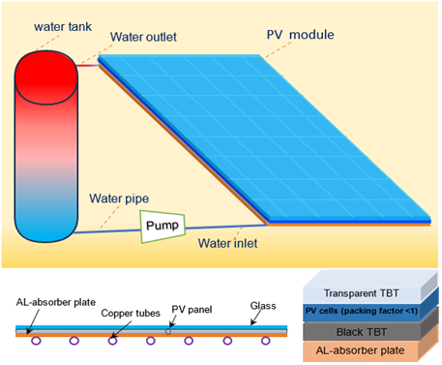
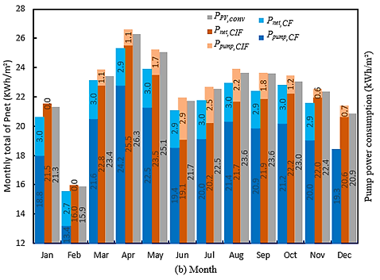
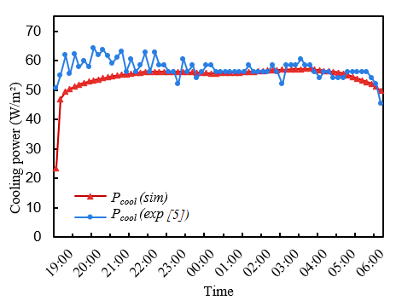
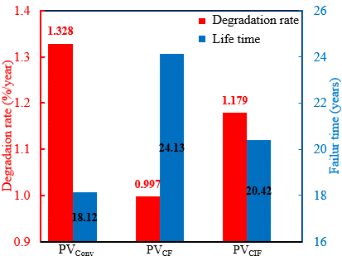
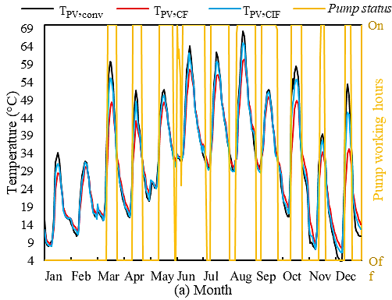
Comprehensive Performance Analysis of a Novel Closed-Loop Photovoltaic Cooling System with Controlled
Intermittent Flow Strategy
Hazim Dirawi¹, Qiliang Wang¹, Mingke Hu², Yuehong Su¹, Saffa Riffat¹
¹Department of Architecture and Built Environment, The University of Nottingham, Nottingham, UK
²School of Electrical Engineering, Southwest Jiaotong University, Chengdu, China
Introduction
Renewable energy sources, such as solar energy, are increasingly popular due to concerns about sustainability and pollution. Photovoltaic (PV) panels, which convert sunlight into electrical energy, are one of the most environmentally friendly sources. However, their efficiency is affected by factors such as solar cell temperature, irradiation, ambient temperature, and weather conditions. In hot and dry environments, the solar cell surface temperature reaches about 125°C [1], reducing efficiency and shortening their lifespan [2]. To maintain and lower the temperature of PV systems, various cooling technologies have been researched to preserve solar energy.
Various methods for cooling, including water cooling, air cooling, phase change material-based, heat pipe-based, and thermoelectric cooling. Effective removal of heat and uniform temperature distribution over the PV panel's surface are critical factors in evaluating the effectiveness of these techniques. Active water-cooling systems, such as spray cooling and hybrid cooling, are one of the most efficient cooling techniques for lowering the operating temperature of PV modules [3,4]. However, conventional water-cooled technologies have application limitations, particularly for arid and hot regions, due to complex structures, large water consumption and significant temperature fluctuation during the day and night. Therefore, designing a novel system that simplifies structure, conserves water, and reduces costs is crucial for these areas.
This study proposes a novel closed-loop PV cooling system with a controlled intermittent flow strategy to regulate PV overheating issues with minimal energy and water consumption. The proposed system is automated to control water flow rates based on PV temperature throughout operation, particularly in hot arid climate regions like Basra, Iraq. Controlled intermittent flow (CIF) is an effective energy-saving solution, allowing the pump to switch on/off as needed. 3D simulation techniques have been used to investigate CIF characteristics in seasonal and annual operating times.
The objective of this research examine the effects of CIF on the performance of PV modules, comparing and evaluating the efficiency of the PV module and net output power with and without a cooling system. The second objective is to assess the impact of different weather conditions on CIF output parameters across various seasons.
Fig. 3. Performance comparison of CIF and CF systems with conventional (a) monthly average of 𝑇_{PV} and (b) monthly total of 𝑃_{𝑛𝑒𝑡}.
Fig. 1. Schematic view of proposed closed-loop hydronic cooling of PV system.
The pump working hours are the lowest during winter and nighttime, which leads to decreased operating time in the CIF system compared to the CF system. The monthly total of 𝑃_{𝑛𝑒𝑡} of the proposed systems with CIF, CF, and conventional PV is presented in Fig.3(b). In all months, the monthly total of 𝑃_{𝑛𝑒𝑡} increases with the use of the CIF system by 5.9% compared to the CF system due to the reduced pump consumption power resulting from decreased working hours, as noted in Fig.3(a).
The performance of the proposed module is evaluated, and the results are validated with experimental data obtained from the study by Hu et al. [5] for both day and night operations. Fig.2 demonstrates that the experimental and simulation cooling powers were highly consistent in the evening operating mode. Over the working period, the mean relative error provided 5.7% of the whole cooling power.
EFFECT ON DEGRADATION RATE AND LIFESPAN
Both CF and CIF systems have a considerable improvement in lifetime of up to 6 years and 2.4 years over conventional PV systems, respectively as seen in Fig.4. However, the results showed that CF cooling systems are predicted to have a longer lifespan than other PV systems. The drawback of CF systems is that they have a high pump operating hour, which reduces net power production as seen above in Fig.3(b).
Fig. 2. Simulation and experimental cooling power at nighttime operating mode.
Results
The thermal and electrical performance of the proposed PV system over 24 hours was numerically investigated according to mathematical modelling in comparison to a conventional PV panel. In addition, the influence of several key factors such as control flow on PV performance was analysed in winter and summer.
The simulated results of the proposed system with CIF, continuous flow (CF), and conventional PV are compared and analysed, using a set PV temperature value (T_{CIF}) of 32°C for CIF during both daytime and nighttime. To avoid continuous pumping operations, the implemented strategy is to have the pump-on only during times when the PV temperature exceeds the T_{CIF} set value.
EFFECT ON PV PERFORMANCE
The effects of the proposed systems over a whole year are investigated in Fig.3 by changing the system from CF to CIF with TCIF=32°C and compared to conventional PV.
Fig. 4. Comparison of degradation rates and failure times among CF, CIF, and conventional PV systems.
Conclusions
The primary conclusions derived from all of this work are:
- The proposed system with CIF reduces seasonal temperature fluctuations and pump power demand by reducing running hours, especially in winter.
- The CIF system is predicted to experience a 14.3% and 1.7% seasonal enhancement in winter and summer compared to the CF system.
The CIF system consistently increases the monthly total of 𝑃_{𝑛𝑒𝑡} by 5.9% compared to CF system due to reduced pump power consumption and working hours.
The study reveals that both CF and CIF systems significantly enhance the lifetime of a conventional PV by up to 33% (6 years) and 13.4% (2.4 years), respectively.
Methodology and validation
The time-dependent simulations were run in a dual mode (day and night). A 3D dynamic CFD model has been developed and this corresponds to a whole day time of 24 hours which was considered to be acceptable in terms of accuracy and efficiency. Compared to a conventional PV module the proposed closed-loop hydronic cooling of a PV system comprises a PV panel of several layers, a water storage tank, water channels and a pump for circulation as illustrated in Fig.1. The efficient area of the PV panel for collecting irradiation is 1.475 x 0.67 m² and the cell area is 0.848 m2. The PV module consists of 36 individuals of cells and a packing factor of 0.858 with 15% conversion efficiency.
The temperature of module layers and water storage tanks is calculated using a COMSOL Multiphysics simulation model. Heat transfer equations are generated for each layer using the basic energy equation, allowing for detailed analysis. The momentum, mass balance, and thermal equations are numerically solved using the finite element method established in COMSOL Multiphysics.
References
[1] Y.F. Nassar, A.A. Salem, The reliability of the photovoltaic utilization in southern cities of Libya, Desalination 209 (2007) 86–90.
[2] M. Mani, R. Pillai, Impact of dust on solar photovoltaic (PV) performance: Research status, challenges and recommendations, Renewable and Sustainable Energy Reviews 14 (2010). https://doi.org/10.1016/j.rser.2010.07.065.
[3] Austin J. Kluth, 6.8.1 Kluth A. Using water as a coolant to increase solar panel, (n.d.). Chrome extension://efaidnbmnnnibpcajpcglclefindmkaj/https://csef.usc.edu/ History/2008/Projects/J0913.pdf (accessed April 1, 2024).
[4] A. Hadipour, M. Rajabi Zargarabadi, S. Rashidi, An efficient pulsed- spray water cooling system for photovoltaic panels: Experimental study and cost analysis, Renew Energy 164 (2021) 867–875.
[5] M. Hu, B. Zhao, X. Ao, X. Ren, J. Cao, Q. Wang, Y. Su, G. Pei, Performance assessment of a trifunctional system integrating solar PV, solar thermal, and radiative sky cooling, Applied Energy 260 (2020).

