Slide 1
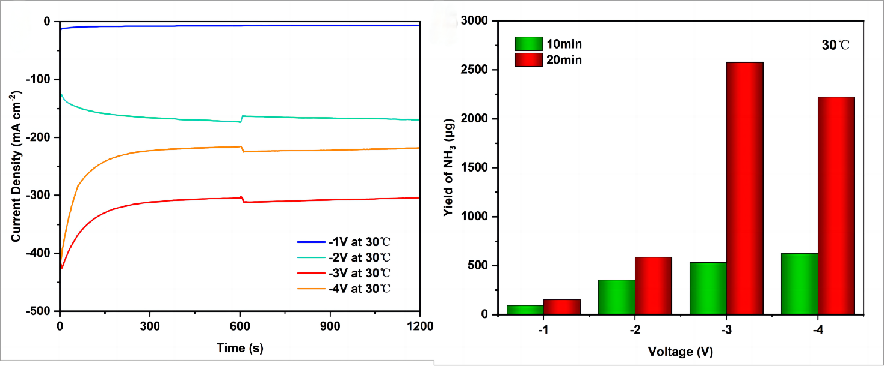
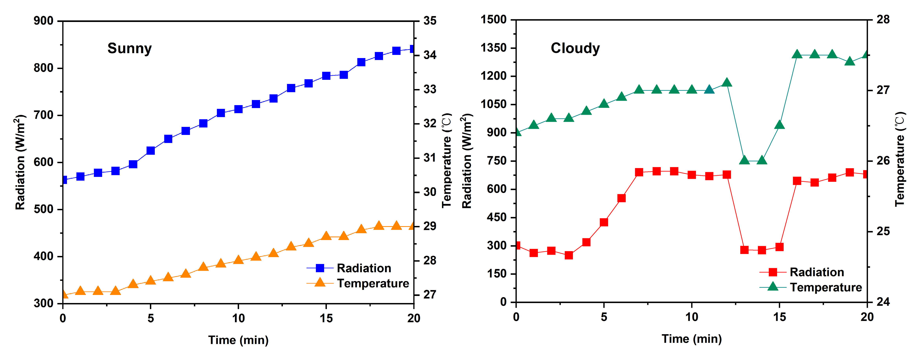
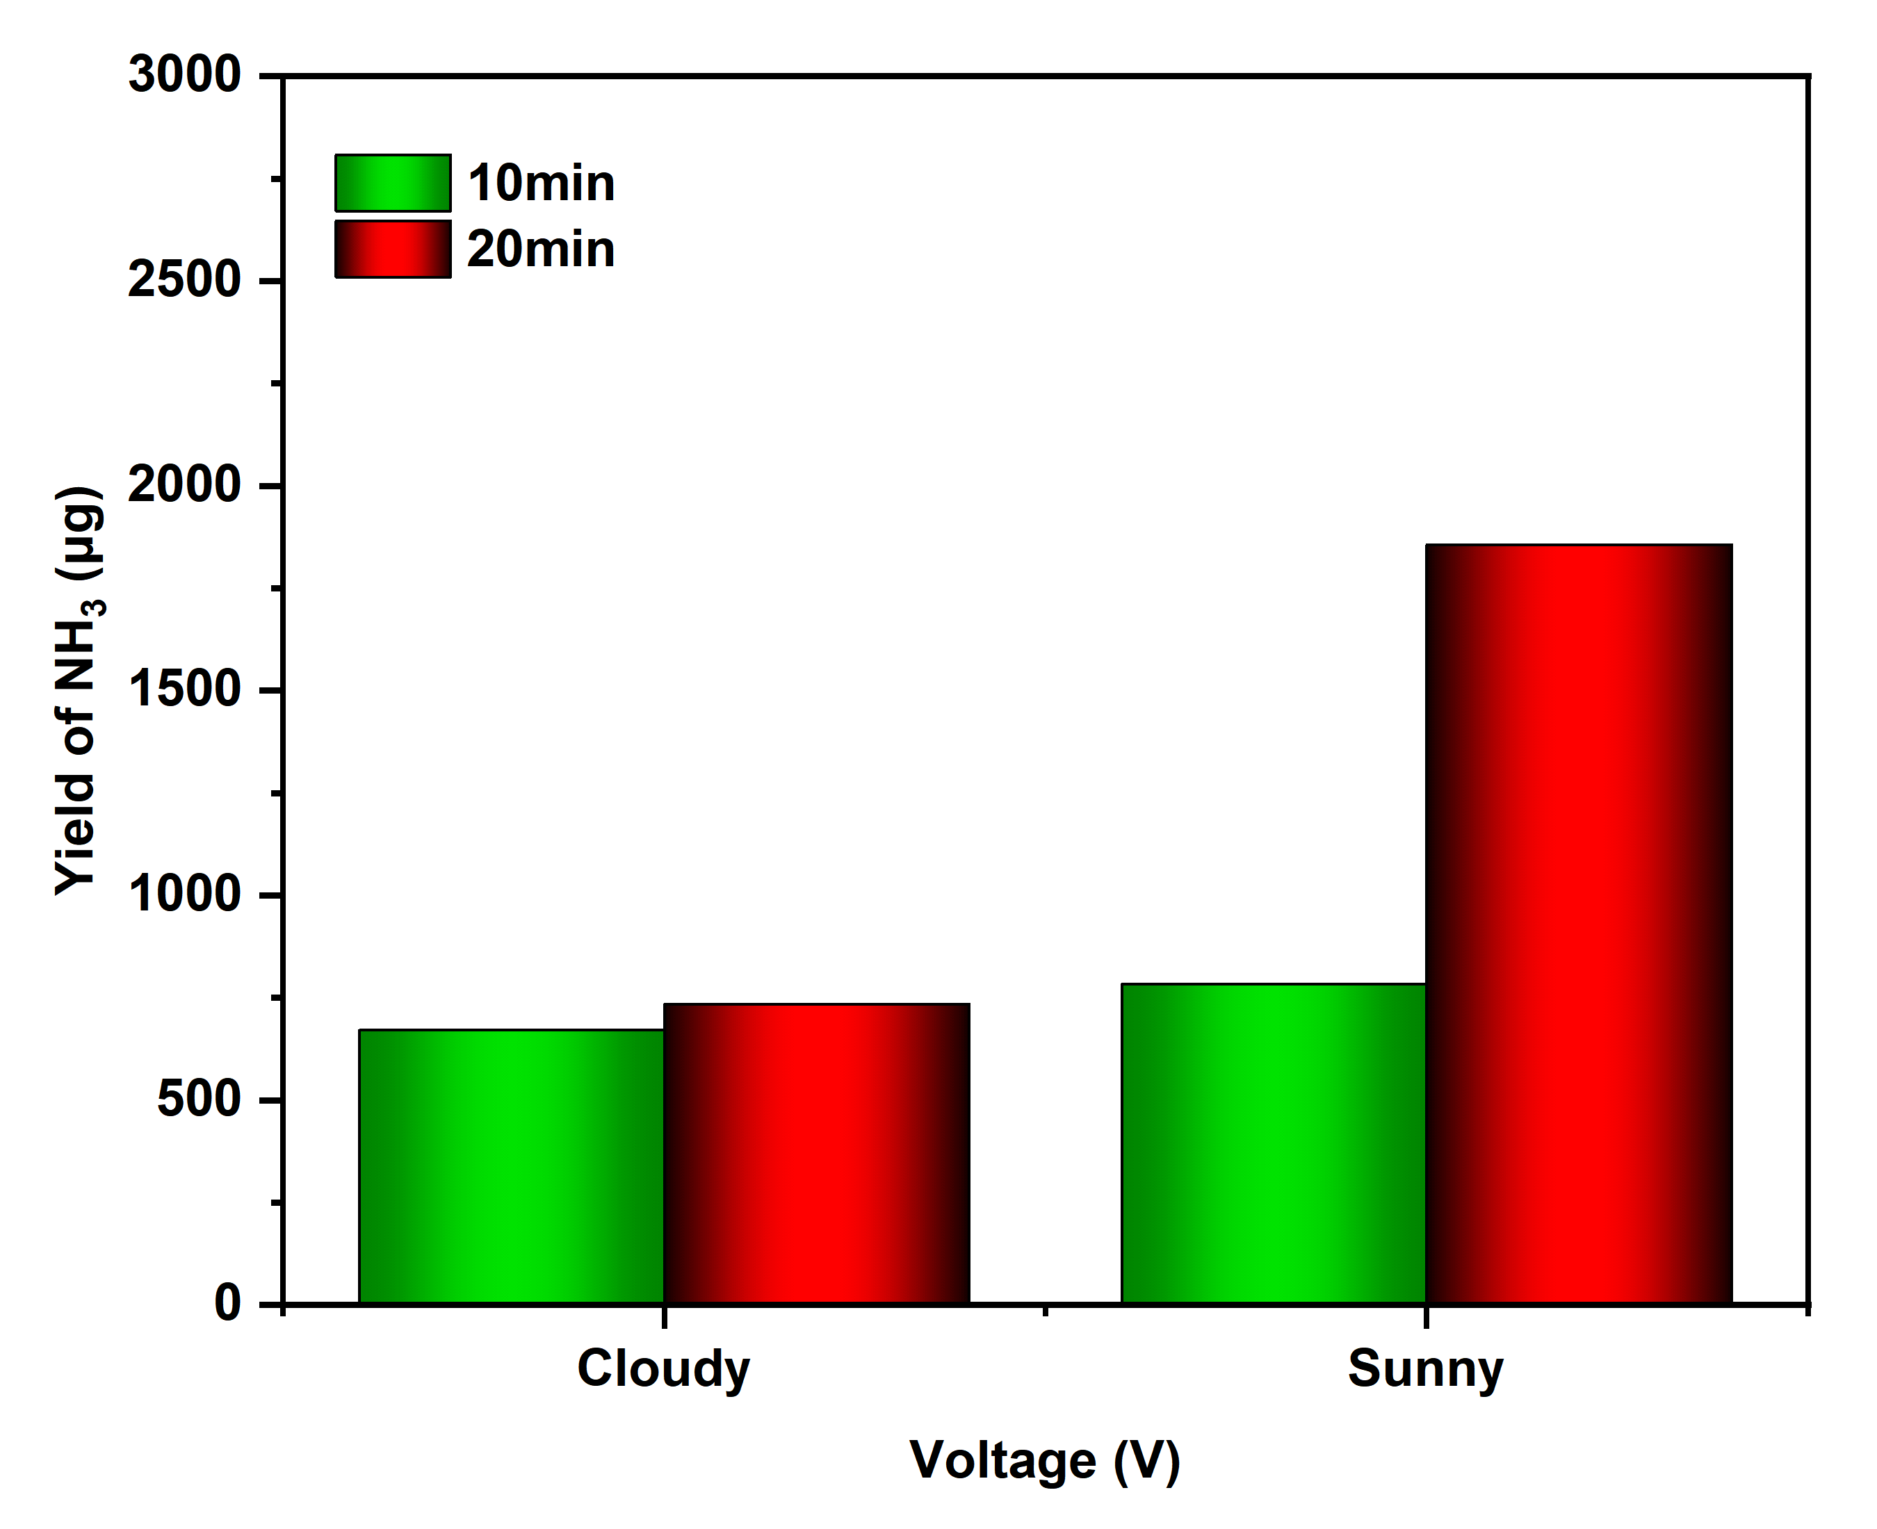
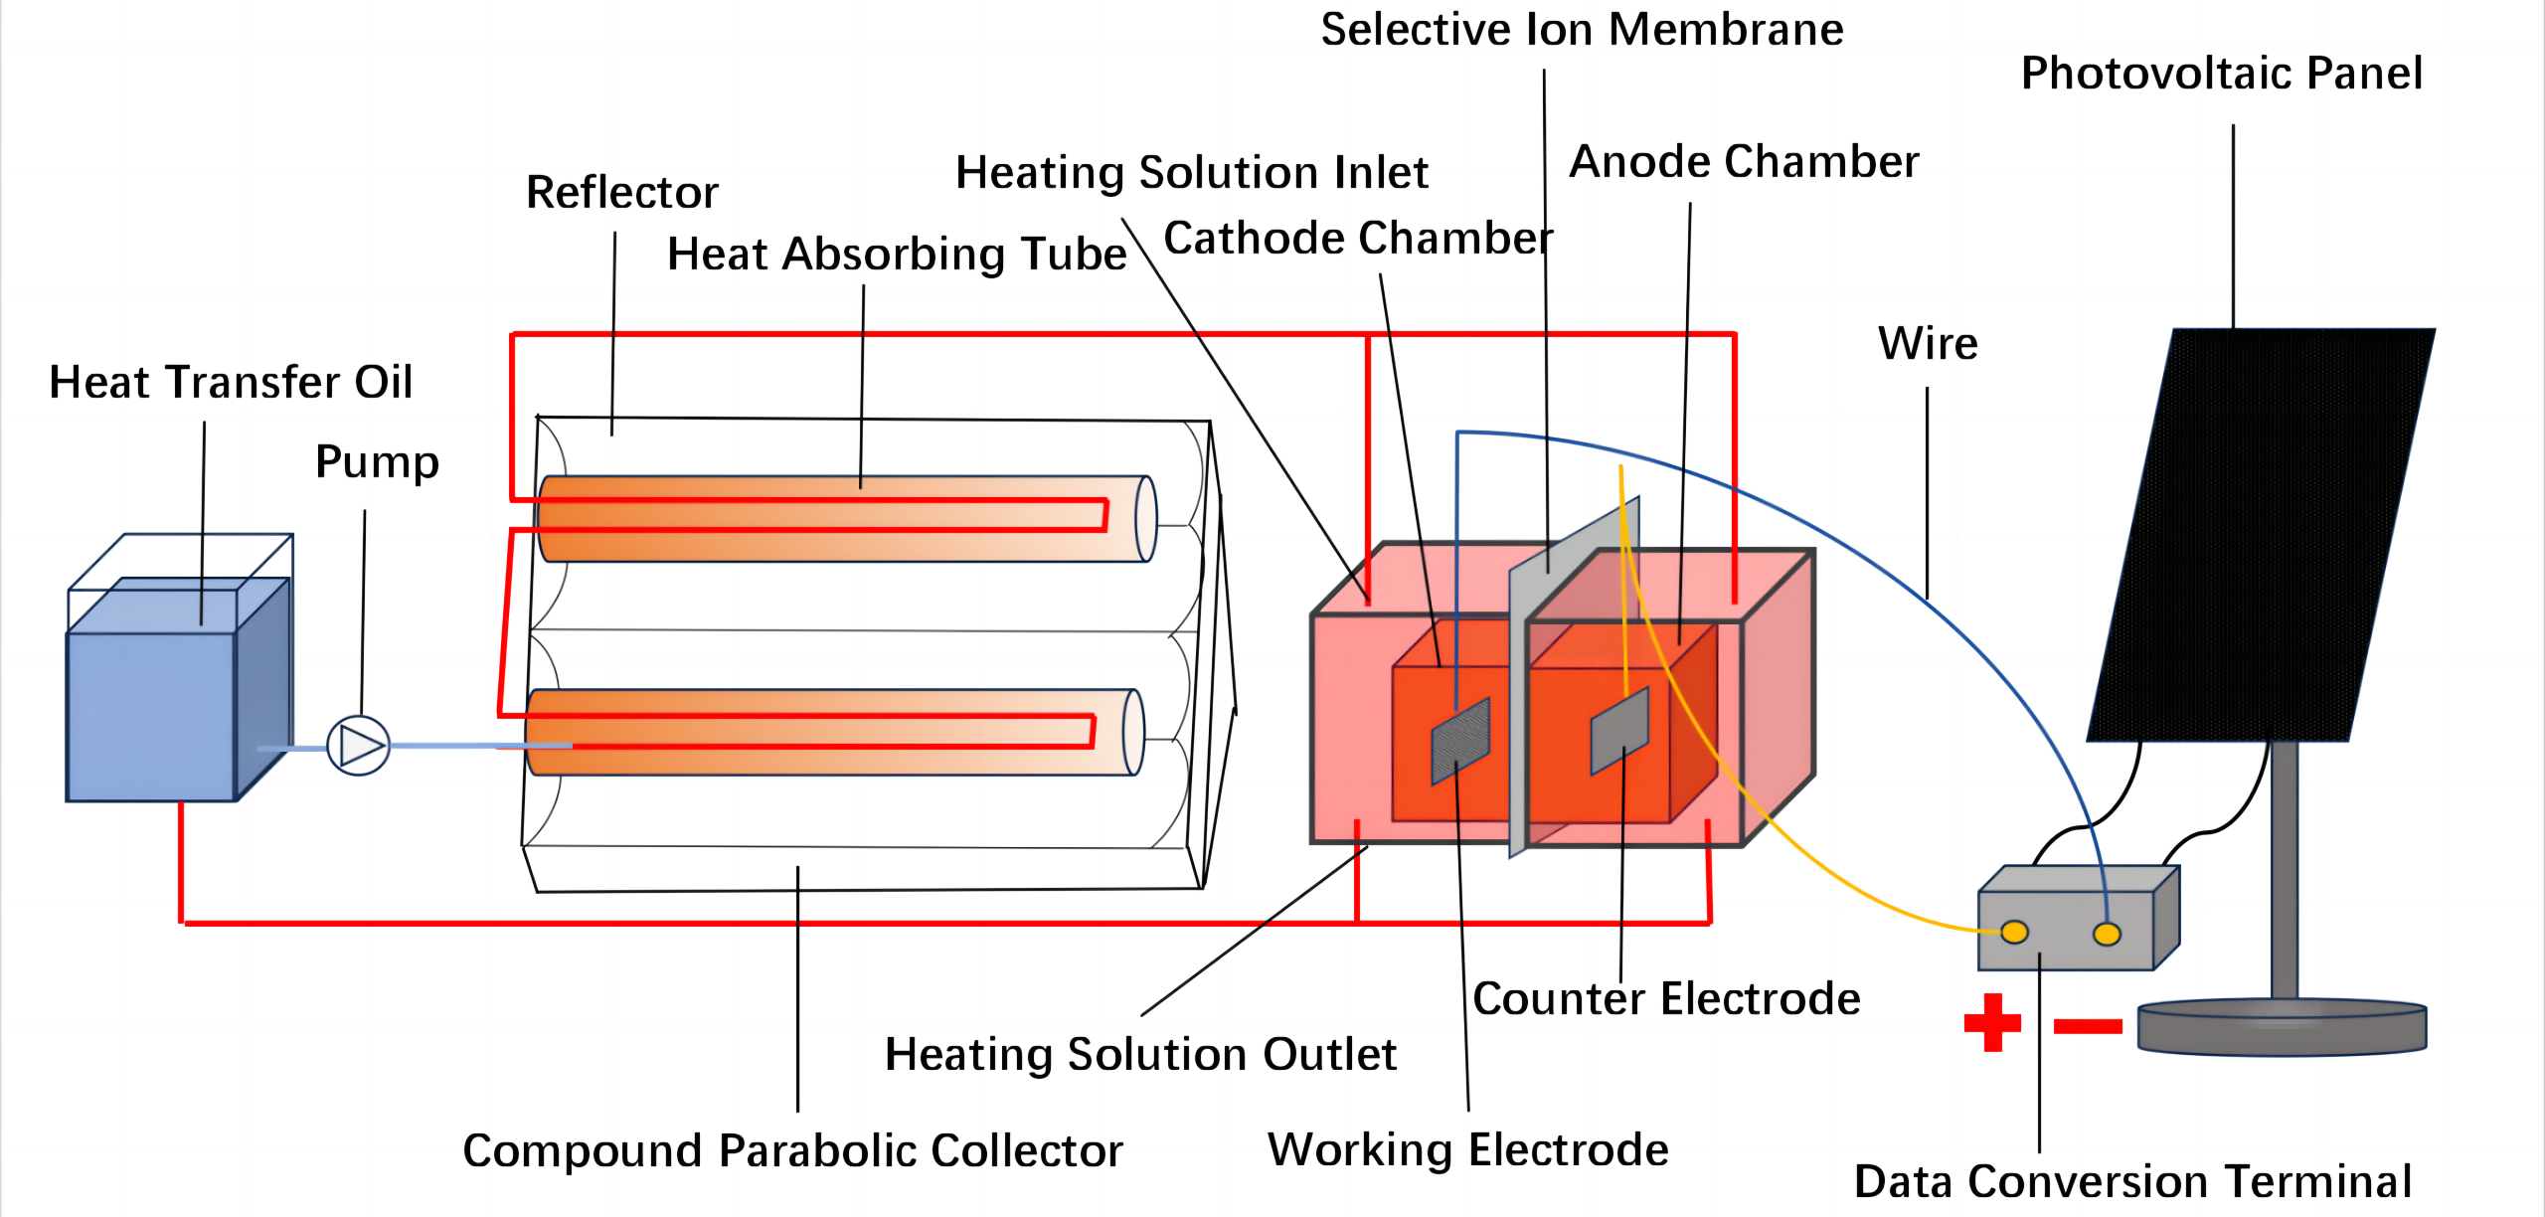
Performance study of solar thermal assisted photovoltaic driven electrocatalytic nitrate reduction
Dingcheng Sun¹,Xu Ji^{1*},Le Zhang¹,Yue Yang¹
Yunnan Normal Univ., School of Energy and Environmental Science, Juxian St. 768, 650500 Kunming, China
Haiyang Xu²,Shengjie Wei²
Yunnan Normal Univ., School of physics and electronic information, Juxian St. 768, 650500 Kunming, China
Introduction
Ⅱ Solar Photovoltaic Utilization Module: This consists of solar photovoltaic panels and data recording and conversion terminals.
Ⅲ Catalytic Nitrate Reduction to Ammonia Module: This comprises the working electrode, counter electrode, ion exchange membrane, cathode chamber, and anode chamber.
Preparation of the Fe-C Catalytic Material
Fe-CDs were synthesized by a slight modification of the previously reported synthesis method of Carbon Nanodots. Briefly, 1 g of citric acid, 1 g of FeCl₃⋅H₂O, and 2 g of urea were dissolved in 10 mL of ultrapure water, then heated for 1 min and 45 s in a microwave oven and the product was obtained by dialysis drying.
Results
The Haber-Bosch process for ammonia synthesis is plagued by issues such as excessive energy consumption and severe pollution [1-3]. In light of the global transition towards sustainable energy, there has been a significant industry focus on developing methods for ammonia production that are both low in energy consumption and free from pollution [4,5].
In order to address the aforementioned issues, the conventional thermo-catalytic NH₃ synthesis has gradually superseded the Haber-Bosch process. However, from a thermodynamic perspective, the thermal catalytic synthesis of ammonia is typically conducted at moderate temperatures and high pressures (400-450 ℃, 150-250 atm), resulting in a conversion rate of 10%-15% [6].
Based on this, we have designed a structurally simple and easy-to-operate solar thermal-assisted electrocatalytic ammonia production system. This system can promote the formation of hydrogen protons under liquid phase conditions and drive their combination with free nitrogen. It significantly reduces the energy consumption involved in the high-temperature cracking of hydrogen and nitrogen gases.
Fig.2. Relationship between voltage and current density, and ammonia production at 30 °C under different voltages
As shown in Fig.2. ,after the system's temperature rises from room temperature to 30 °C, the current density significantly increases. The ammonia production of the system at -1 V, -2 V, -3 V, and -4 V is 151.9 μg, 585.2 μg, 2577.3 μg, and 2221.4 μg, respectively. Moreover, at -1 V, the ammonia production of the system at 10 minutes is 93.4 μg, and at -3 V for the same duration, the ammonia production is 530.9 μg. From this, it can be seen that with the increase in temperature, the ammonia production of the system has a significant improvement compared to room temperature.
Experiment
The effect of different temperatures on the Ammonia production of the System
Before testing, a certain volume of nitrate solution is injected into the cathode and anode chambers, respectively. Steady-state testing procedure: The ammonia production was tested under stable conditions at different voltages and temperatures of room temperature, 30 °C, 40 °C, and 50 °C. The specific experimental procedure involves heating the heat transfer medium to a specific temperature using a constant temperature water bath, and then turning on the circulation pump to pump the heat transfer medium into both the cathode and anode chambers.
Effects of ambient temperature and irradiance on ammonia production
Weather-dependent testing procedure: Before testing, the heat transfer medium is pumped into the compound parabolic concentrating collector using a water pump for heating. The heated heat transfer medium is then discharged outside the cathode and anode chambers to complete the process of heating the nitrate solution. Once the cathode and anode chambers reach a specific temperature, the photovoltaic panels are connected to the working electrode and the counter electrode. After setting a certain voltage, the process of photo-thermal assisted electrocatalytic reduction of nitrate is carried out. After the test is completed, a certain amount of liquid is taken out from the cathode chamber for product detection.
Experimental setup
The study explored the system under both variable temperature conditions and actual environmental conditions. Under variable temperature conditions, an electric heater was used to control the temperature of the ammonia synthesis system, with an electrochemical workstation providing the power; in actual environmental conditions, a composite parabolic collector and photovoltaic panels were utilized as the heat and power sources for the ammonia synthesis system, investigating the impact of different climatic conditions on the system's ammonia production performance. By adjusting climate conditions, voltage, current, and temperature, the ammonia production performance of the system was optimized.
Construction of the system
The solar thermal-assisted electrocatalytic ammonia production system is mainly divided into three parts:
Ⅰ Solar Thermal Utilization Module: This includes the Compound Parabolic Collector (CPC), reflective mirror surface, heat absorption tube, and wastewater storage section.
Fig. 3. Relationship between ammonia production and different irradiance and temperature under actual environmental conditions on sunny and cloudy days.
As shown in Fig.3., under two different conditions of cloudy and clear skies, the temperature of the system increases with the increase in irradiance, and the ammonia production of the system also increases accordingly, with ammonia production reaching 1856.3 μg and 734.7 μg, respectively.
Conclusions
This paper presents a a solar photothermal-assisted electrocatalytic ammonia synthesis system, exploring the effects of various reaction conditions such as temperature and voltage on ammonia production performance. The results indicate that, under conditions of 30 °C and -3 V, the system achieves a maximum average current density of 300 mA·cm⁻² and a maximum ammonia production of 2577.3 μg. Experimental analysis under actual environmental conditions demonstrates the system's high practical application value, suggesting the potential for further research in the future.
References
[1] Wang L, Xia M, Wang H, Huang K, Qian C, Maravelias CT, et al. Greening Ammonia toward the Solar Ammonia Refinery. Joule. 2018.
[2] Capdevila-Cortada M. Electrifying the Haber–Bosch. Nature Catalysis. 2019.
[3] Kyriakou V, Garagounis I, Vourros A, Vasileiou E, Stoukides M. An Electrochemical Haber-Bosch Process. Joule. 2019.
[4] Seh ZW, Kibsgaard J, Dickens CF, Chorkendorff I, Nørskov JK, Jaramillo TF. Combining theory and experiment in electrocatalysis: Insights into materials design. Science. 2017.
[5] Diego M, Angel S, Maksim Z, Jorge G. Challenges and opportunities for the photo-(thermal) synthesis of ammonia. Green Chemistry. 2023.
[6] Rouwenhorst KHR, Van der Ham AGJ, Lefferts L. Beyond Haber-Bosch: The renaissance of the Claude process. International Journal of Hydrogen Energy. 2021;46(41):21566-79.
Fig.1. Structural diagram of solar thermal-assisted electrocatalytic ammonia production system

