Slide 1



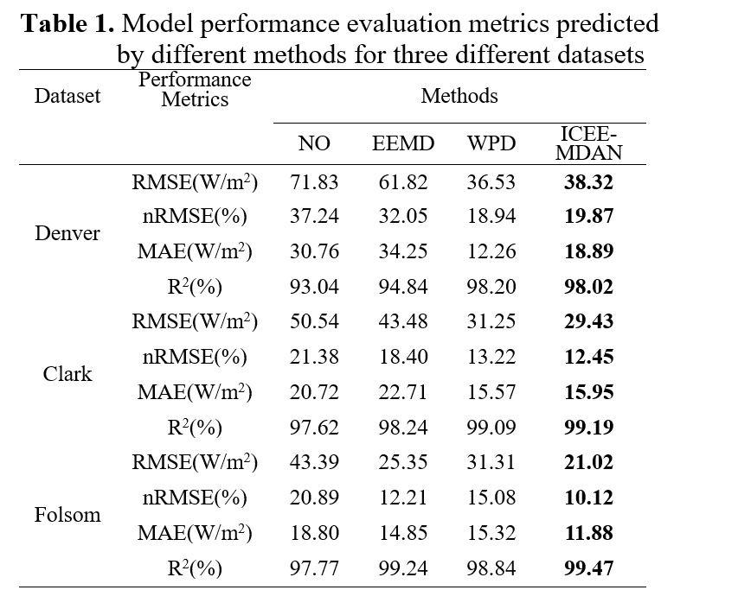
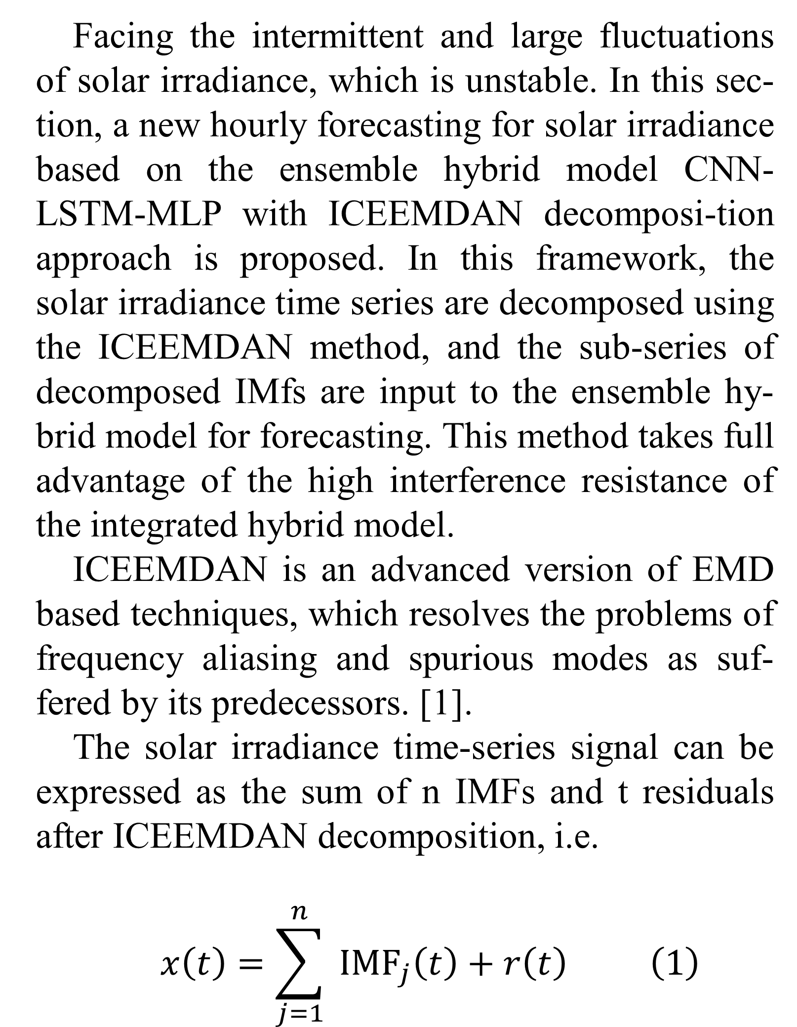
Hourly forecasting for solar irradiance based on ensemble hybrid model CNN-LSTM-MLP with
ICEEMDAN decomposition approach
Jun Liu¹, Xiaoqiao Huang ^{1*}, Yonghang Tai¹
1 School of Physics and Electronic Information, Yunnan Normal University, Kunming, Yunnan 650500, China
Introduction
Results
Discussion
Fig.2. Denver dataset randomized 48-hour prediction
effect of different methods.
Photovoltaic power generation is different from traditional energy generation such as hy-dropower, thermal power, and nuclear power with continuous, adjustable, and controllable charac-teristics. Photovoltaic power generation systems are affected by various meteorological factors, such as the intensity of solar radiation and envi-ronmental temperature. Its output power has ob-vious intermittent and fluctuating characteristics. When large-scale PV power generation is inte-grated into the electricity grid, its intermittency and fluctuations exacerbate the complexity of grid management. However, the prediction ac-curacy of the majority of the current models is not very satisfactory, and the models are inadequate in terms of anti-interference ability and general-ization ability. To truly put the prediction models into practical applications, further optimization of the schemes needs to be completed to improve the comprehensive prediction performance of the models. Therefore, to address the above faced challenges, in this study, an ICEEMDAN-CNN-LSTM-MLP scheme for hourly solar irradiance forecasting was proposed.
In this work, irradiance measured from mete-orological ground stations is used to predict irra-diance for the next hour. three real-world datasets were used to evaluate the performance of the proposed model in hourly irradiance prediction. the three datasets are Denver, Clark, and Folsom, all located in the United States, containing pri-marily air temperature, humidity, historical irra-diance, wind speed, and other relevant weather parameters hourly historical data from Denver, Clark and Folsom are from the measurement and instrumentation data center (MIDC) of the natio-nal solar radiation database, provided by the na-tional renewable energy laboratory, https://midcdmz.nrel.gov.
The conventional evaluation metrics root mean square error (RMSE), standardized root mean square error (nRMSE), mean absolute error (MAE), and square of R (R2) were also calculated for three different datasets to evaluate the effec-tiveness of the model. The results corresponding to the calculated metrics and visualization results for the different data sets are shown in Table 1 and Figs. 2 to 3.
From Table 1 and Figs. 2 to 3, it can be seen that the ICEEMDAN method proposed in this paper has obvious advantages compared with the other three methods, with RMSE, nRMSE, and MAE all close to the minimum value, and the three indi-cators of the more volatile Denver data set can still reach 38.32, 9.87, and 18.89, respectively;R2 is almost close to 1, and the more volatile Denver data set can also reach 98.02%, showing a more satisfactory prediction effect.
Methodology
    Facing the intermittent and large fluctuations of solar irradiance, which is unstable. In this sec-tion, a new hourly forecasting for solar irradiance based on the ensemble hybrid model CNN-LSTM-MLP with ICEEMDAN decomposi-tion approach is proposed. In this framework, the solar irradiance time series are decomposed using the ICEEMDAN method, and the sub-series of decomposed IMfs are input to the ensemble hy-brid model for forecasting. This method takes full advantage of the high interference resistance of the integrated hybrid model.
    ICEEMDAN is an advanced version of EMD based techniques, which resolves the problems of frequency aliasing and spurious modes as suf-fered by its predecessors. [1].
    The solar irradiance time-series signal can be expressed as the sum of n IMFs and t residuals after ICEEMDAN decomposition, i.e.
    $$x\left(t\right)=\sum_{j=1}^{n}{ }{IMF}_{j}\left(t\right)+r\left(t\right) \left(1\right)$$
    Fig. 3. Corresponding performance metrics for three different data sets.
Conclusions
  To improve the prediction accuracy, general-izability and having stronger robustness of the model, in this paper, a new hourly forecasting for solar irradiance based on the ensemble hybrid model CNN-LSTM-MLP with ICEEMDAN de-composition approach is proposed.
Acknowledgements
  This research was funded by the National Natural Science Foundation of China (61875171, 61865015), which is gratefully acknowledged by the author.
References
Fig.1. Simplified diagram of the new prediction architecture proposed in this paper.
[1] M. Sibtain, X. Li, S. Saleem, Qurat-Ul-Ain, M.S. Asad, T. Tahir, H. Apaydin, A Multistage Hybrid Model ICEEMDAN-SE-VMD-RDPG for a Multivariate Solar Irradiance Forecasting, IEEE Access. 9, 37334–37363 (2021).

