Slide 1
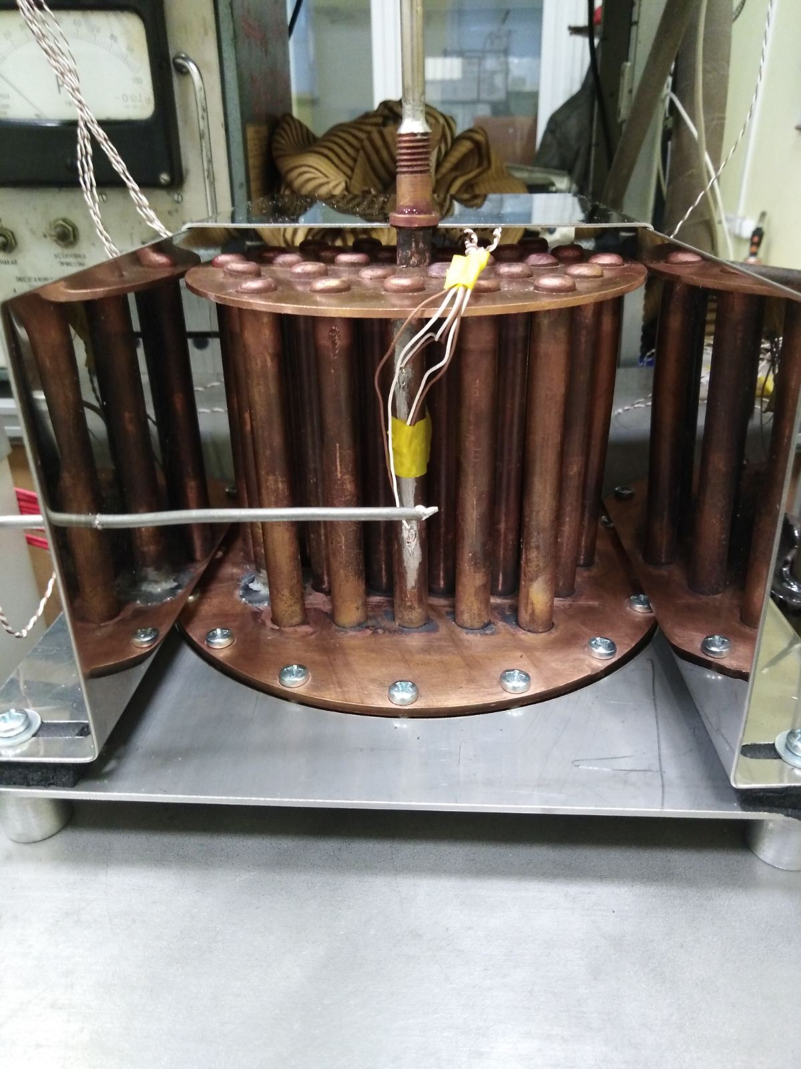
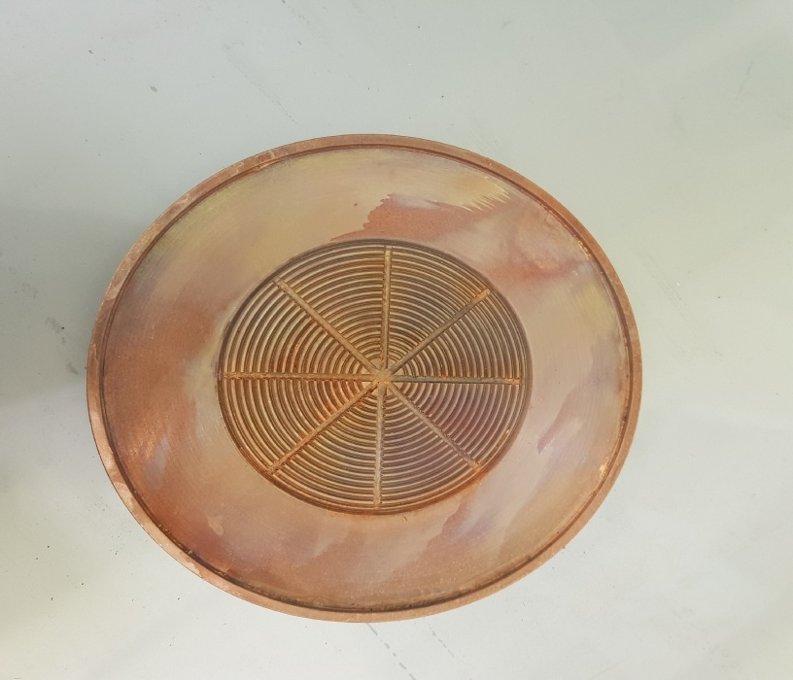
Loop thermosyphon for cooling high-power electronic devices
L. L. Vasiliev 1, A. Georgiev 2, L. P. Grakovich 1, M. A. Kuzmich 1, M. I. Rabetsky 1
1. A.V. Luikov Heat and Mass Transfer Institute, National Academy of Science of Belarus, P. Brovka Str.15, 220072,
Minsk, Belarus
2. A. Georgiev
Department of Mechanics, TU of Sofia, branch Plovdiv, Bulgaria
Introduction
Conclusions
Loop two-phase thermosyphons have a high heat transmitting capability and operate very stably. They are autonomous and silent [1-2]. Their operation does not require energy consumption, which is important for the wireless electric transport. In the solar power engineering thermosyphons in combination with vapor chamber are capable of intensely removing heat from PV and PVT panels, ensuring appropriate isothermality of the surface and maintaining the temperature optimal for the service of photo transformers.
  A novel type of an evaporative loop thermosyphon has been suggested, developed and tested to ensure the temperature regimes of powerful heat-generating electronic devices. The removed heat fluxes can reach 1.5 kW with heat flux densities up to 100 W / cm2.The positive effect of the porous coating of the evaporation surface on the intensification of heat transfer in this zone is shown. The degree of intensification is in the range of 2.4-1.4 times, depending on the heat load of the evaporator. The total thermal resistance of the thermosyphon from the heat source to the cooling medium is 0.1 K/W when the condenser is cooled by the air flow and 0.015 - 0.02 K/W when the condenser is cooled by the water flow.
Fig.2 Thermal resistances of the thermosyphon as a heat load dependence.
Experiment
Construction of thermosyphon
The capillary grooves of the triangular profile in the thermosyphon evaporator are designed for better distribution of the incoming working fluid over its surface. This arrangement makes it possible to actively and evenly wet the entire heat exchange surface in the evaporator.
The main goal of the performed experiments was to achieve the minimum possible values of the thermal resistances of the thermosyphon components (the maximum values of the heat transfer coefficients during evaporation, boiling and condensation of the heat carrier). A layer of sintered copper powder with a thickness of about 150 μm was applied to the surface of the grooves of the evaporator (powder with dendritic particles of 60-100 μm was used).
This method of intensifying heat transfer was used to increase the parameters of the thermosyphon. The values of thermal resistances and heat transfer coefficients were determined from the readings of the temperatures of the surfaces of the evaporator, condenser and saturated vapor. During experiments with thermosyphon it was noticed that the porous coating of the mini fins in the evaporator gives us a possibility transmitting heat flow which exceeds 1 kW. The thermal resistances of the device and the corresponding heat transfer coefficients show its high efficiency. With an increase in the density of the heat flow supplied to the evaporator, the heat transfer coefficient increases due to the intensification of heat transfer during boiling of the working fluid. Currently, there is a large amount of experimental data confirming the intensification of heat transfer when the evaporation surface is covered with a layer of porous material /3-5/. Due to the use of porous materials, the evaporation surface significantly increases, and the number of vaporization centers increases.
The porous coating of the evaporator made it possible to increase the heat transfer intensity from 60,000 to 90,000-100,000 W/m2K. The effect of decreasing thermal resistance is especially noticeable at relatively low heat transfer fluxes. Obviously, this is due to a significant increase in the evaporation surface area due to the pores of the coating. In the case of intense boiling at high heat fluxes, part of the coating pores is occupied by vapor, and the intensification effect is somewhat reduced.
Experimental set-up of thermosyphon is shown in Fig.1.
Experimental setup of thermosyphon
References
1. Nicolas Lamaison, Jackson B. Marcinichen, Chin Lee Ong and John R.Thome. Two-Phase Mini-Thermosyphon Electronics Cooling, Part 4: Application to 2U Servers. 978-1-4673-8121-5.2016 IEEE.15th IEEE ITHERM Conference
2. Chin Lee Ong, Nicolas Lamaison, Jackson B. Marcinichen and John R.Thome.Two-Phase Mini-Thermosyphon Electronics Cooling, Part 1: Experimental Investigation. 978-1-4673-8121-5. 2016 IEEE. 15th IEEE ITHERM Conference.
3. Gangtao Liang, Issam Mudawar, Review of pool boiling enhancement by surface modification, International Journal of Heat and Mass Transfer 128 (2019) 892–933,
4. D.H. Min, G.S. Hwang, Y. Usta, O.N. Cora, M. Koc, M. Kaviany,2-D and 3-D modulated porous coatings for enhanced pool boiling. International Journal of Heat and Mass Transfer 52 (2009) 2607–2613.
5. Vasiliev L.L., Grakovich L.P., Rabetsky M.I., Vassiliev L.L.Jr., Heat transfer enhancement in heat pipes and thermosyphons using nanotechnologies (nanofluids, nanocoating, and nanocomposites), Heat Pipe Science and Technology, an International Journal. 2013. Vol.4. No.4. P.251-275.
Fig.1 Experimental set-up and mini-channels on the heat loaded surface of the evaporator
Experimental set-up of thermosyphon is shown in Fig.1.The evaporator of thermosyphon is a copper plate with capillary grooves of triangular profile in the heat flow supply zone. The condenser is a set of 27 vertically arranged copper tubes with closed top ends. On the basis of the developed devices, heat exchangers can be used for water heating and cooling systems in the equipment of the housing and communal services sector. In the proposed design, the working fluid of thermosyphon evaporates on the evaporator flat mini finned surface and condenses inside the cooled vertically arranged condenser tubes, the inner surface of the tubes is smooth. Condensate from the tubes flows down to the evaporator surface under the action of gravity.
In the Fig.2 the thermal resistance is noted as R_{e} - resistance of the thermosyphon evaporator , R_{c} - condenser and R_{tot} – total thermal resistance.
    .

