Slide 1
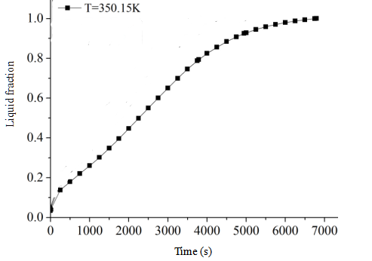
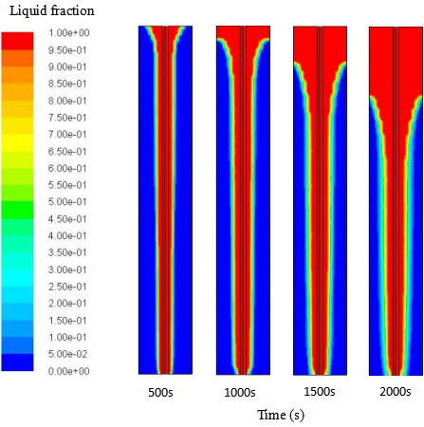
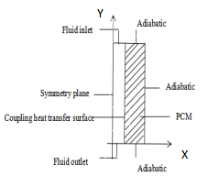
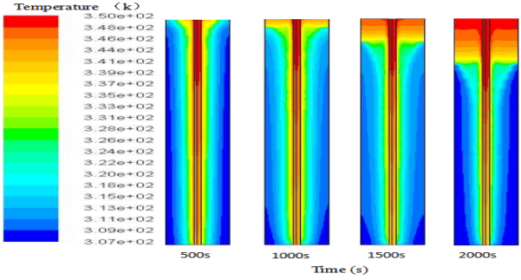
Numerical Simulation of Paraffin Heat Storage Process in Concentric Tube Heat Exchanger
Y.Li*, G.Y. You, Q.Z. Zhu*, M.L. Di, G. Yue
College of Energy and Mechanical Engineering, Shanghai University of Electric Power, Shanghai 200090, ChinaBusso
Introduction
Results
Conclusions
The development of heat storage technology plays an important role in improving energy efficiency. It has wide application prospects in the use of solar radiation energy , the recovery of industrial waste heat, the "peak shifting valley filling" of the power industry, and phase change material composite walls, etc., and has become a research hotspot worldwide.
Simulating the paraffin energy storage process in concentric circular tubes to obtain the melting law of the phase change material in the circular tube phase change heat exchanger can provide a reference and basis for enhancing the heat transfer process of the phase change energy storage heat exchanger .
The melting process of paraffin at an initial temperature of 298.15 K, a thermal fluid velocity of 0.045 m/s, and a thermal fluid inlet temperature of 350.15 K are simulated, and the following laws are obtained.
The main conclusions drawn from all these work are:
- The liquid phase fraction is between 0 and 0.8, and the slope of the liquid phase rate curve is basically unchanged. Between 0.8 and 1, the slope of the curve gradually becomes smaller.;
- When the melting time is 500 s, high temperature first appears near the entrance, and melting starts from here. ;
- Since the draw ratio is relatively large, as the melting process progresses, the heating zone is first heated from the inner tube to the outer tube, but the time is very short, and then the heat transfer is performed from top to bottom.;
Physical model and mathematical model
Fig.2. Variation curve of liquid phase volume fraction of paraffin with time
References
The external dimensions of the concentric circular tube phase change heat exchanger are as follows: the outer tube diameter is 40 mm and the height is 400 mm, the inner tube diameter is 6 mm and the height is 400 mm. The phase change material paraffin is filled in concentric circular tubes. The 1/2 area of the heat storage unit along the y direction is selected as the calculation area, and the center line of the inner tube is a symmetric boundary to establish a two-dimensional model, as shown in Fig. 1.
[1] Zhang H, Baeyens J, Cáceres G, et al. Thermal energy storage: Recent developments and practical aspects[J]. Progress in Energy & Combustion Science, 2016, 53:1-40.
[2] Medrano M, Yilmaz M O, Nogues M, et al. Experimental evaluation of commercial heat exchangers for use as PCM thermal storage systems[J]. Applied Energy, 2009, 86(10): 2047-2055.
[3] Seddegh S, Wang X, Henderson A D. Numerical investigation of heat transfer mechanism in a vertical shell and tube latent heat energy storage system[J]. Applied Thermal Engineering, 2015, 87: 6
[4] Ma T, Yang H, Zhang Y, Lu L, Wang X. Using phase change materials in photovoltaicsystems for thermal regulation and electrical efficiency improvement: A review andoutlook. Renew Sustain Energy Rev 2015;43: 1273–84.
Fig.3. The fraction field at different moments
Fig.1. Physical model of paraffin wax heat storage process in concentric circular tubes
Fig.4. The temperature field at different moments

