Slide 1
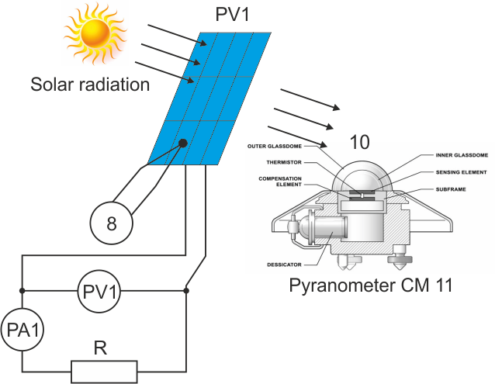
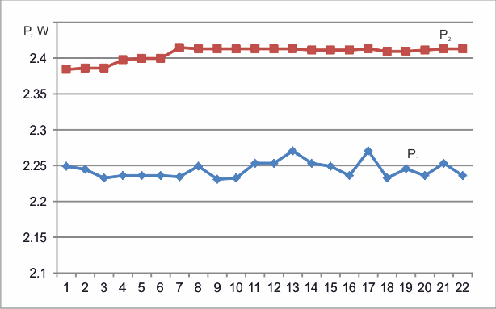
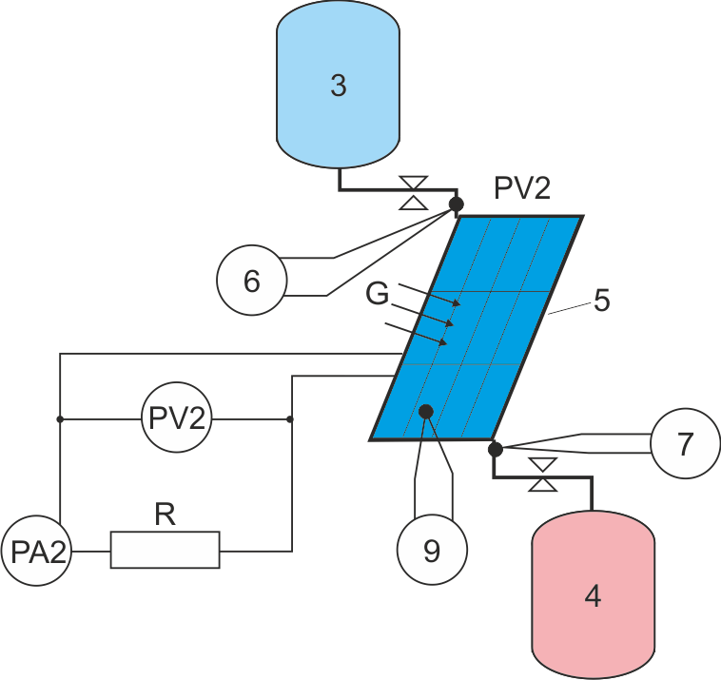
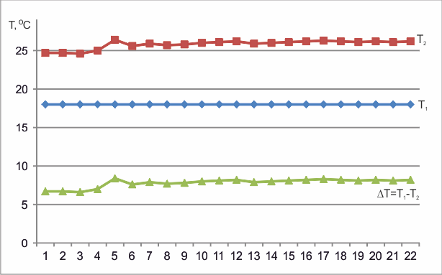
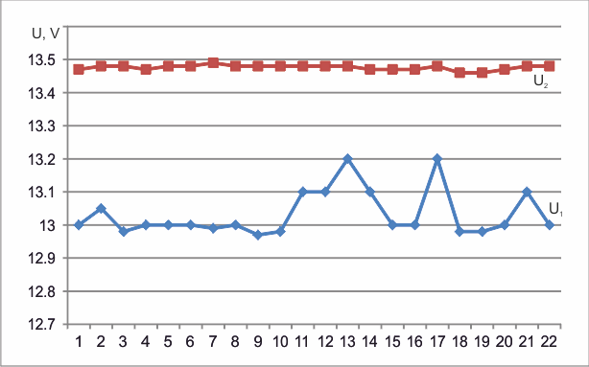

An Approach for Optimising the Operation of a Photovoltaic System Using Cogeneration
I. Stoyanov
Department of Electric Power Engineering, "Angel Kanchev" University of Ruse, Bulgaria
T. Iliev
Department of Telecommunications, "Angel Kanchev" University of Ruse, Bulgaria
Introduction
One way for a more complete utilization of solar energy is through cogeneration (CHP) to another type of energy. In this way a photovoltaic system with cogeneration allows for the simultaneous production of electricity and other type of energy. It is known that in the working process the Photovoltaics are heated up. This is a prerequisite for cogeneration of PV modules by the simultaneous production of electric and thermal energy. Thus using cogeneration allows for increasing the energy efficiency of photovoltaic systems. Optimal operation means to achieve the best performance of the photovoltaic system. Having in mind some limitations, optimal would be what provides the best service or system state. Extreme value of an adopted functional (or function) for quality assessment acts as a criterion for optimality [1, 4, 5].
The task for analytical design of optimal regulator is a problem for searching and maintaining some extremum (maximum or minimum) [2, 3]. Moreover, it is to determine the differential equation or transfer function of the controller.
The purpose of this paper is to determine the optimal operating mode of a photovoltaic system using cogeneration for producing electricity and thermal energy.
Fig. 4. Changes of P₁, P₂, W
The magnitudes of current and voltage of the cold module are larger than those of the reference. Also, due to the constant temperature of the cooling module is observed little influence of other factors on the magnitude of the current, voltage and output power.
With cooling improves the performance of the photovoltaic module with about 7% compared to the reference
Conclusions
Experimental results
In this article is presented hypothesis for the possibilities of improving the performance of photovoltaic systems, through cogeneration of thermal energy. Based on the theory of optimal control was carried out mathematical analysis for the type of closed cogeneration system.
During the research was developed an experimental system for studying the operation of a photovoltaic system with cogeneration of electricity and heat. The obtained preliminary results are proving the efficiency and feasibility of the proposed solution. With the use of a heat exchanger the heat is dissipated from the photovoltaic module, thereby increasing its efficiency with about 7%, whilst is carried out heating of the water by 7.8 ºС.
The proposed approach is suitable for optimizing the operation of a photovoltaic system by using cogeneration and achieving a balance between electrical and thermal generation of the photovoltaic systems.
To achieve the desired objective is created and developed an experimental system consisting of two identical photovoltaic modules PV (1, 2), water inlet tank (3) water outlet tank (4) heat exchanger mounted on the rear side of the photovoltaic panel (5), digital thermometers to measure the temperature of the inlet (6) and the outlet (7) of water at the outlet of the heat exchanger and measuring the temperature of the reference (8) and cooling (9) photovoltaic module, pyranometer CM11 (10), two digitals ampermeters and two voltmeters (Figure 1) [4].
Solar radiation falling on the surface of the photovoltaic modules is the primary source of electricity generation, but at the same time the modules are heated to a certain temperature. The two modules are mounted on a common support and are oriented at the same angle to the sun. One of the rear side a heat exchanger, made of a spirally wound pipe is firmly attached. For heat transfer medium is used water. The transfer of heat from the photovoltaic module to the water is done by conduction and convection.
The heat flow ($Q_{t})$can be determined by the expression:
${ Q}_{t}=∆t.V.ρ.c.\left(T_{2}−T_{1}\right), Wh$ (1)
where:
$∆t$ – the interval of time in which the heat exchange was
performed, h;
$V$ – mass flow, l/h;
$ρ$ – specific density, kg/l;
$c$ - specific heat capacity of water;
$T_{1}, T_{2}$ – respectively the temperature of the water inlet and outlet, ºС.
The amount of heat that is released by the module and absorbed by the water can be determined by the calorimetric equation
$Q=m.c\left(T_{2}−T_{1}\right)$, (2)
where:
$m$ – the water mass, kg.
    Fig. 1. Scheme of the experimental system.
On figure 2, 3 and figure 4 are presented results from the preliminary research.
References
Fig. 2. Changes of T₁, T₂ and the difference ΔТ, ºС
[1] Joe-Air J., T. Huang, Y. Hsiao, Ch. Chen. Maximum Power Tracking for Photovoltaic Power Systems. Tamkang Journal of Science and Engineering, Vol. 8, No 2, 147-153 (2005).
[2] Ramos A., Maria Anna Chatzopoulou, Ilaria Guarracino, James Freeman, Christos N. Markides. Hybrid photovoltaic-thermal solar systems for combined heating, cooling and power provision in the urban environment. Energy Conversion and Management, Vol. 150, 15 October 2017, Pages 838-850 (2017).
[3] Rachev, S., Stefanov, D., Dimitrov, L., Koeva, D. Evaluation of Electric Power Losses of an Induction Motor Driving a Compact Electric Vehicle at Change of Parameters and Loads. Electric Vehicles International Conference, (2019).
[4] Zlatov, N., Iliev, I., Terziev, A., Kamburova, V. Influence of climatic data and degradation factor on the efficiency of the photovoltaic modules. 15th International Workshop on Research and Education in Mechatronics, REM 2014.
[5] Mangesh, S., G. Priya, P. Ghosh, S, Bandyopadhyay. Optimization of photovoltaic–thermal (PVT) based cogeneration systemthrough water replenishment profile. Solar Energy, Volume 133, August 2016, pp. 512-523 (2016).
Fig. 3. Changes of U₁, U₂, V
  Analysis of the results shows that as a result of the heat exchange water temperature has risen by an average of 7,8 ºC. The difference ΔT was almost constant.

