Slide 1
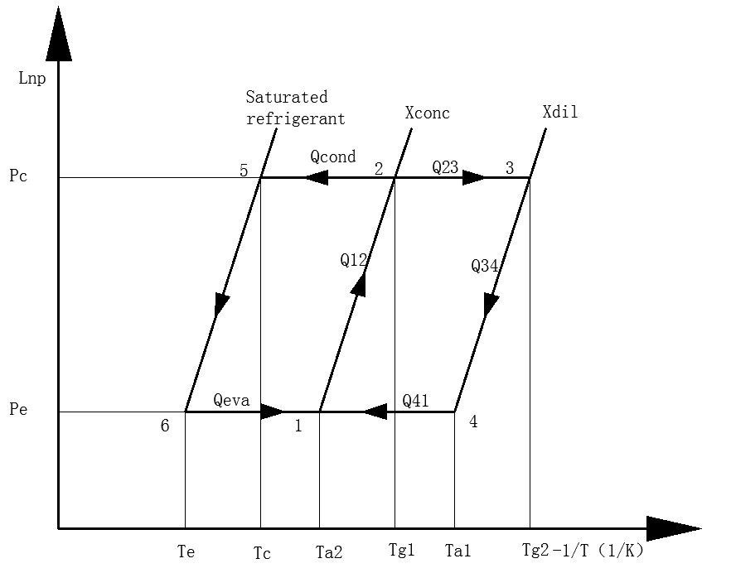
Exergy analysis and performance optimization of adsorption refrigeration system
Leilei Yan¹, Xu Ji^{2*}, Haiyang Xu², Yue Wang¹,Jishu Li²
¹Yunnan Normal University, School of physics and electronic information,768 Juxian Str, Kunming,650500, China
² Yunnan Normal University, School of energy and environmental science,768 Juxian Str, Kunming,650500, China, jixu@ynnu.edu.cn
Introduction
Adsorption refrigeration systems have the benefits of energy savings if powered by waste heat or solar energy. At present, energy (first law) analysis is still the most commonly used method in the analysis of thermal systems. The first law is concerned only with the conservation of energy, and it gives no information on how, where, and how much the system performance is degraded. Exergy analysis is a powerful tool in the design, optimization, and performance evaluation of energy systems. V. Baiju et al investigated performance of a refrigeration cycle by using artificial neural network based on the exergy analysis [1]. Mohammad Sharifzadeh et al investigated the temporal irreversibility in adsorption beds, condenser, evaporator, and expansion valve, and also the irreversibility due to external thermal coupling [2].
Fig. 3. Exergy in an adsorption bed at different heating temperatures and condensation pressures
Fig. 7. The COP of the cycle at different heating temperatures and condensation pressures
Conclusions
Experimental system
In this paper, analyzes the changes of the exergy loss and efficiency of the adsorption refrigeration system at different stages, and discusses the effect of different heating temperature, evaporation temperature, condensation temperature and different condensation pressure on the performance of the adsorption refrigeration system. Concluded as follow.
(1) The largest component of exergy loss in the adsorption refrigeration system is the adsorption bed and the condenser, and its maximum proportion of system loss is 54% and 30% respectively. During the constant pressure desorption process of the adsorption refrigeration system, the exergy loss of the adsorption bed increases with the increase of the heating temperature and decreases with the increase of the condensing pressure. The maximum rate of change is 73% and 59%, respectively. The exergy efficiency of the adsorption bed decreases with the increase of the heating temperature and decreases with the increase of the condensing pressure. The maximum rate of change is 20% and 22% respectively;
(2) In the constant volume cooling process of the adsorption refrigeration system, the exergy loss of the condenser increases with the increase of the heating temperature and decreases with the increase of the condensation temperature. The maximum rate of change is 79% and 74%, respectively. The exergy efficiency of the condenser decreases with the increase of the heating temperature and increases with the increase of the condensation temperature . The maximum rate of change is 48%, 45%;
(3) In the adsorption refrigeration system, the loss of the evaporator during the constant pressure adsorption process increases with the increase of the cooling temperature of the adsorption bed, and decreases with the increase of the evaporation temperature. The maximum rate of change is 73% and 59%, respectively; The efficiency decreases with the increase of the cooling temperature of the adsorption bed, and decreases with the increase of the evaporation temperature, and the maximum change rates are 0.8% and 2%, respectively;
Fig. 4. Exergy and exergy efficiency of the condenser at different heating and condensing temperatures
Fig. 1. Thermodynamic process of adsorption refrigeration cycle
.
Figure.1 shows the four basic thermodynamic processes of adsorption refrigeration. In the figure, x_{dil} and x_{conc} are the mass of refrigerant adsorbed per unit mass of adsorbent at the beginning and end of desorption (adsorbent adsorption rate); t_{g1} and t_{g2} are the desorption temperature at the beginning and end; t_{a1} and t_{a2} are the temperature at the beginning and end of adsorption. The four processes are: (1-2) for constant volume heating process, (2-3) for constant pressure desorption process, (3-4) for constant volume cooling process, (4-1) for constant pressure adsorption process.
Test results
Fig. 5. Exergy loss and efficiency at different evaporation temperatures and bed temperatures
References
[1] Journals Baiju, V., et al., Exergy Assessment of Single Stage Solar Adsorption Refrigeration System Using ANN. ISRN Mechanical Engineering, 2012.
[2] Journals Sharifzadeh, M., M. Ghazikhani, and H. Niazmand, Temporal exergy analysis of adsorption cooling system by developing non-flow exergy function. Applied Thermal Engineering, 2018. 139.
Fig. 2. Desorption amount change under different desorption temperature and condensing pressure
Fig. 6. Exergy efficiency of the system at different heating temperatures and condensation pressures

